Slide 1
Photo Album
by Paula Shore

Slide 2
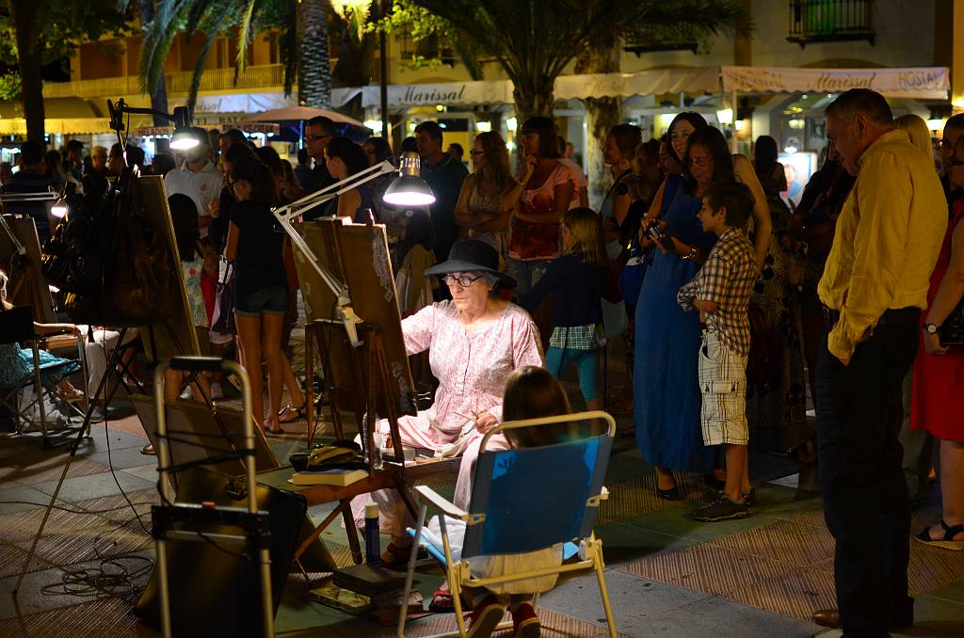
SPAIN IN JULY 2015 – SUMMER – 80-90 DEGREES
A BEAUTIFUL AND FAMILIAR COUNTRY. It was very hot, but we spent most of our time by the sea or in it. The evenings were warm and many people entertained us on the streets.

Slide 3
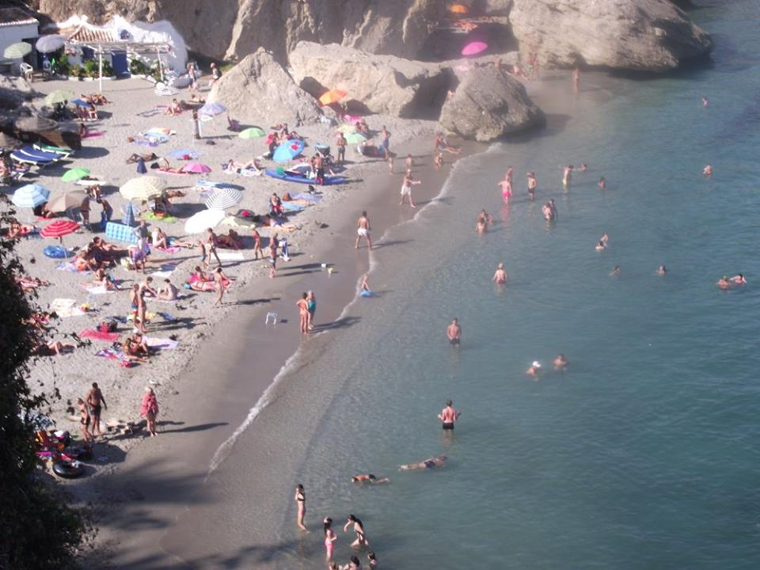

Slide 4
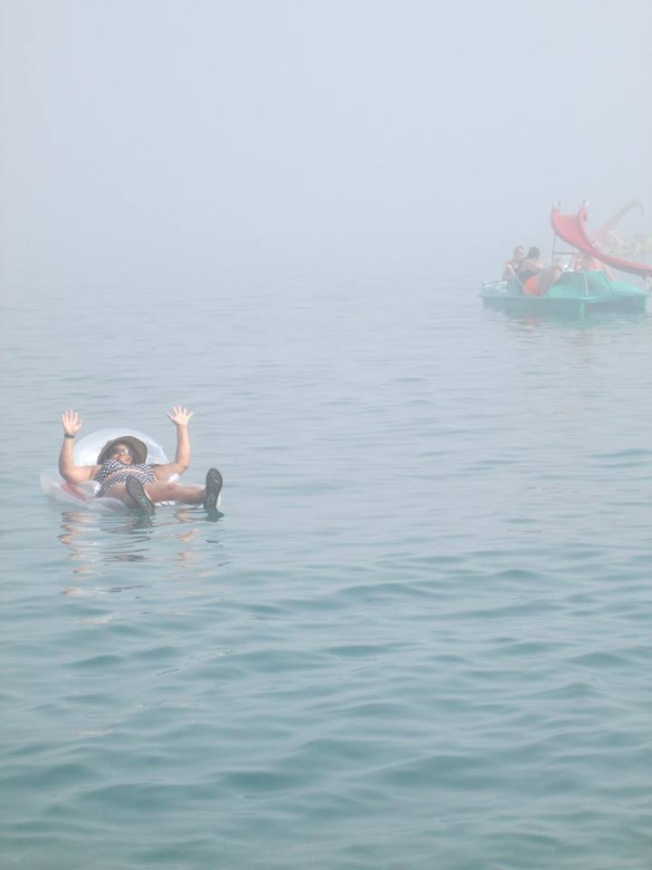

Slide 5
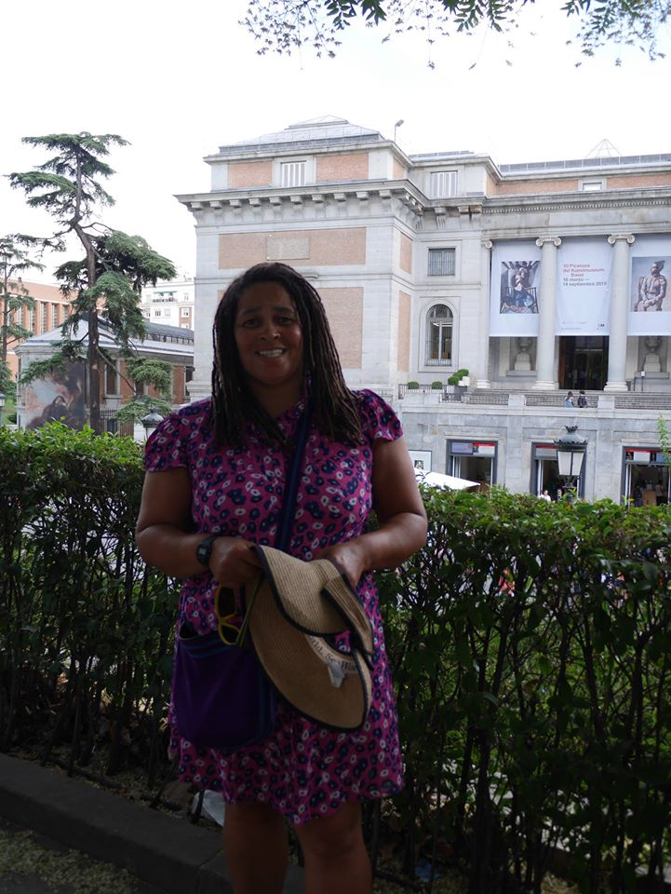

Slide 6
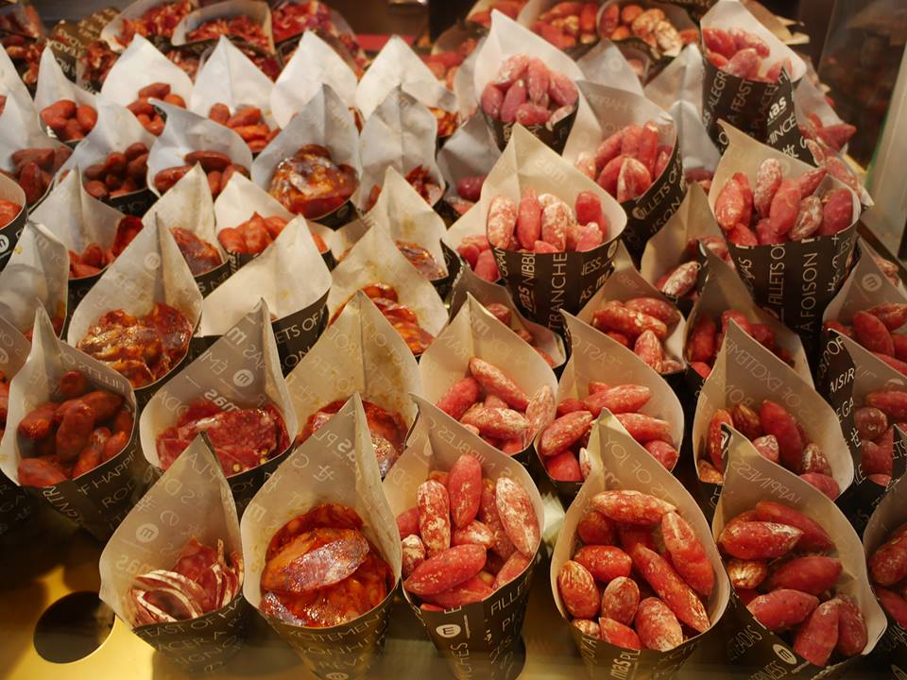

Slide 7
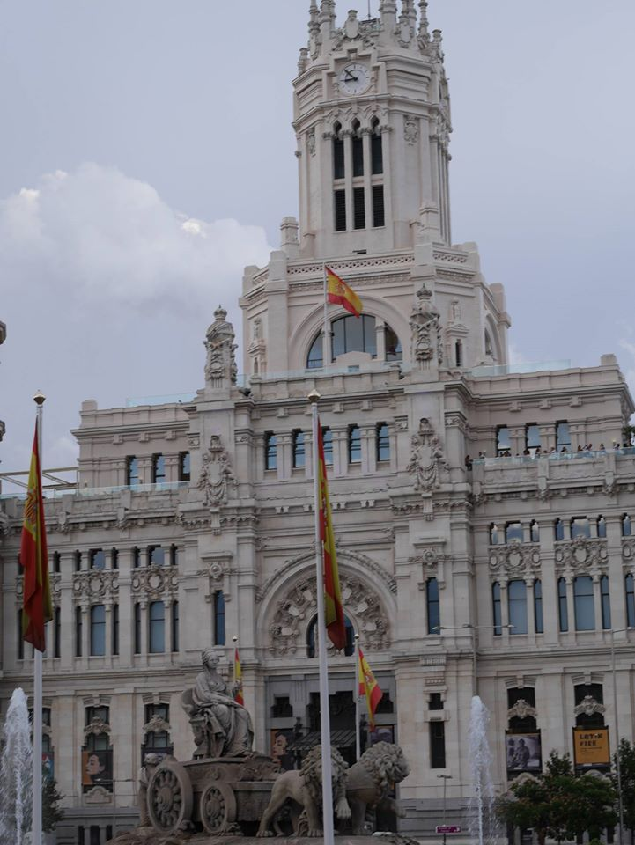

Slide 8
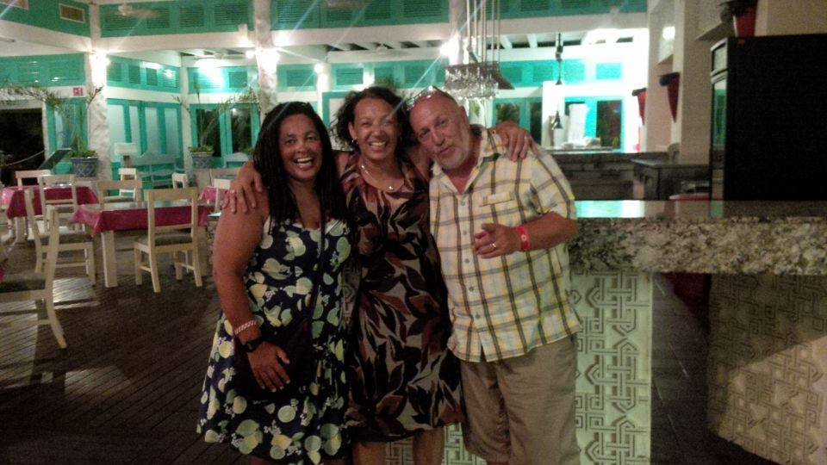
MEXICO – AUGUST 2015 SUMMER - 80 DEGREES
The people were so kind in Mexico. We loved the stories about their history and loved looking at where the ancient Mayans once lived. Mexico had the best beaches. I also met a friend from London who was also holidaying there.

Slide 9
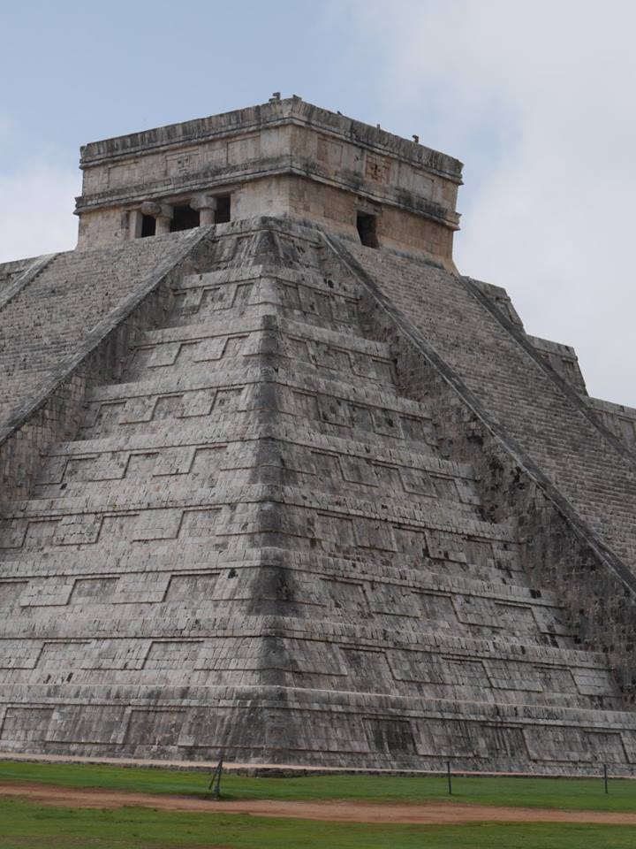

Slide 10
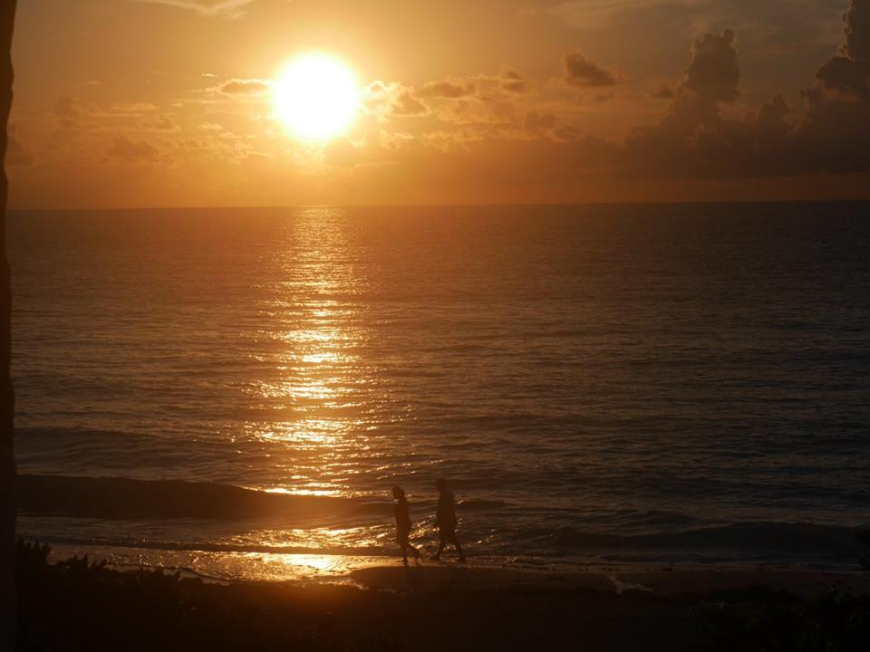

Slide 11
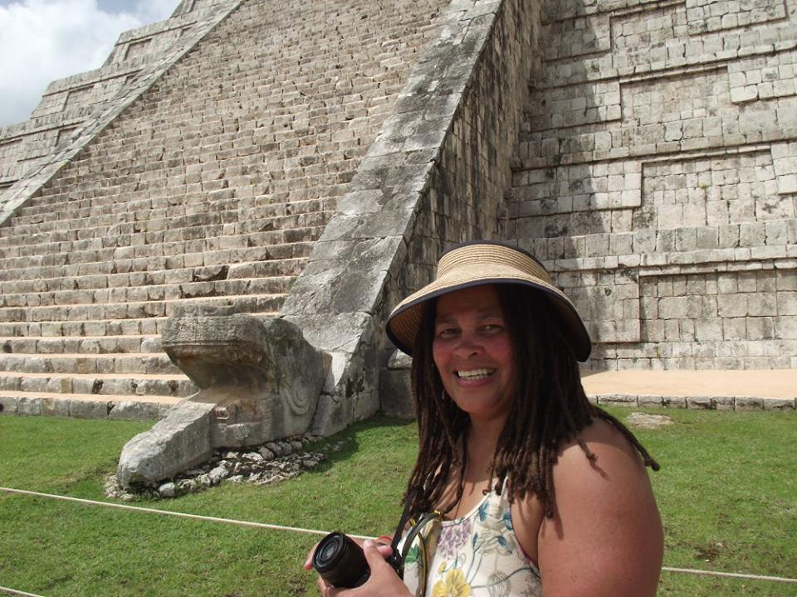

Slide 12
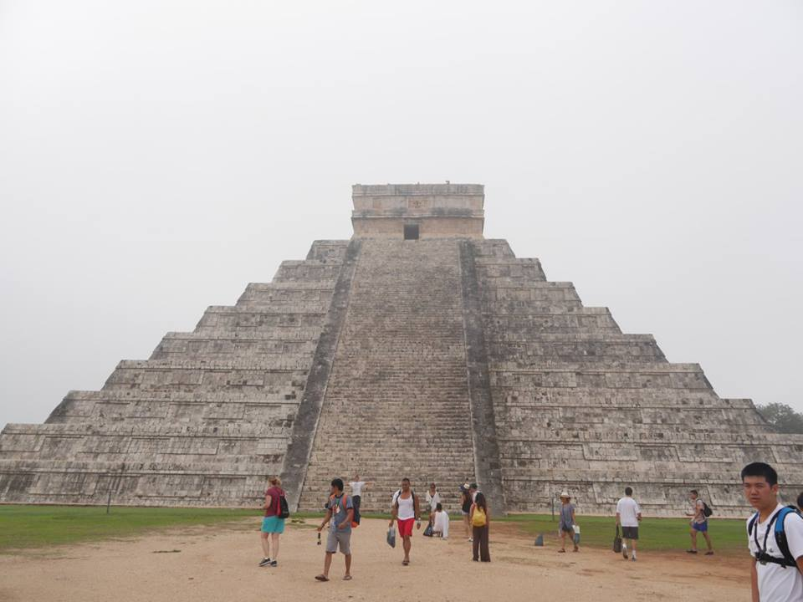

Slide 13
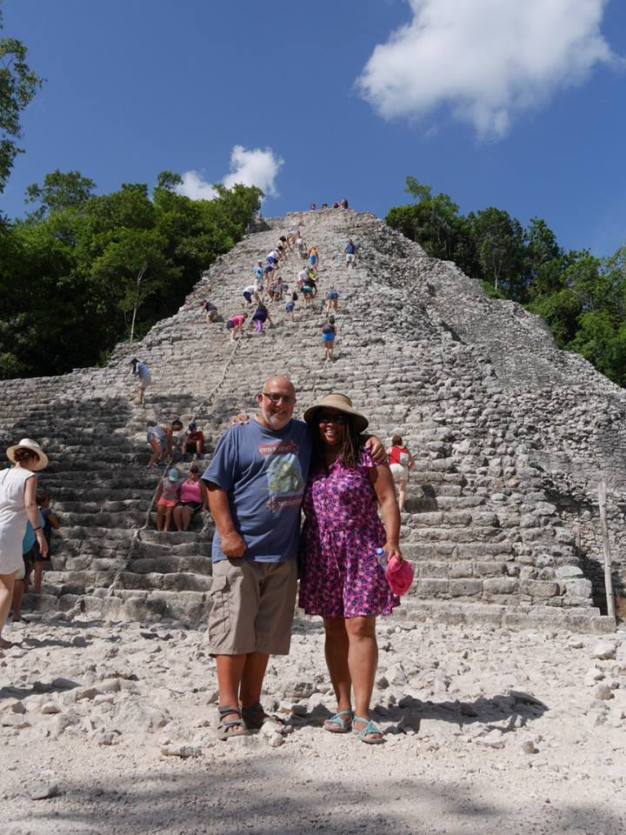

Slide 14
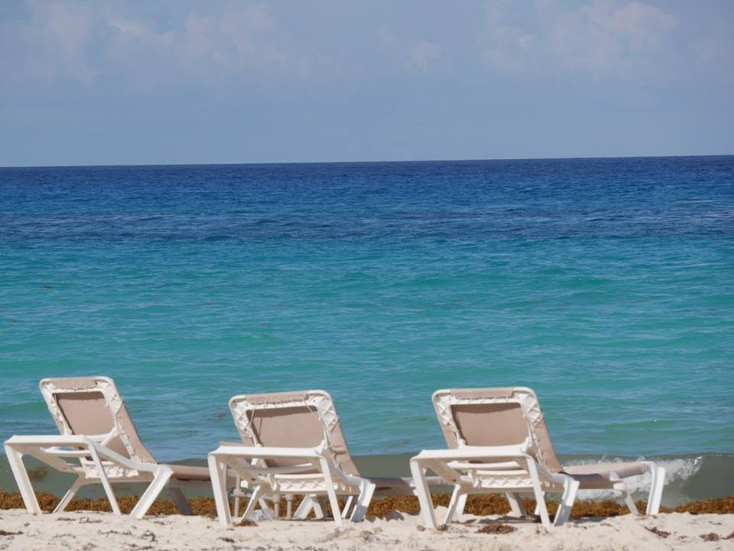

Slide 15
COSTA RICA IN AUGUST – RAINY SEASON - 75 DEGREES
We saw so much wildlife in Costa Rica and spent a lot of time on or in water, including capsizing in a crocodile infested river. Very scary.

Slide 16
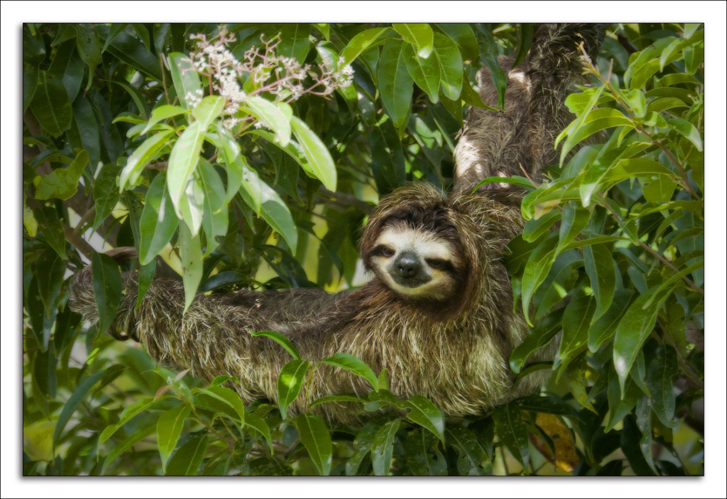

Slide 17
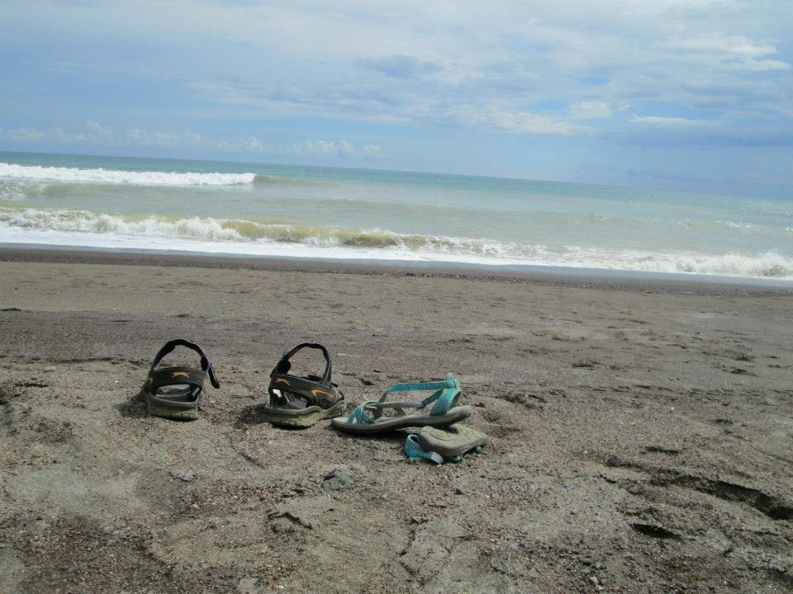

Slide 18
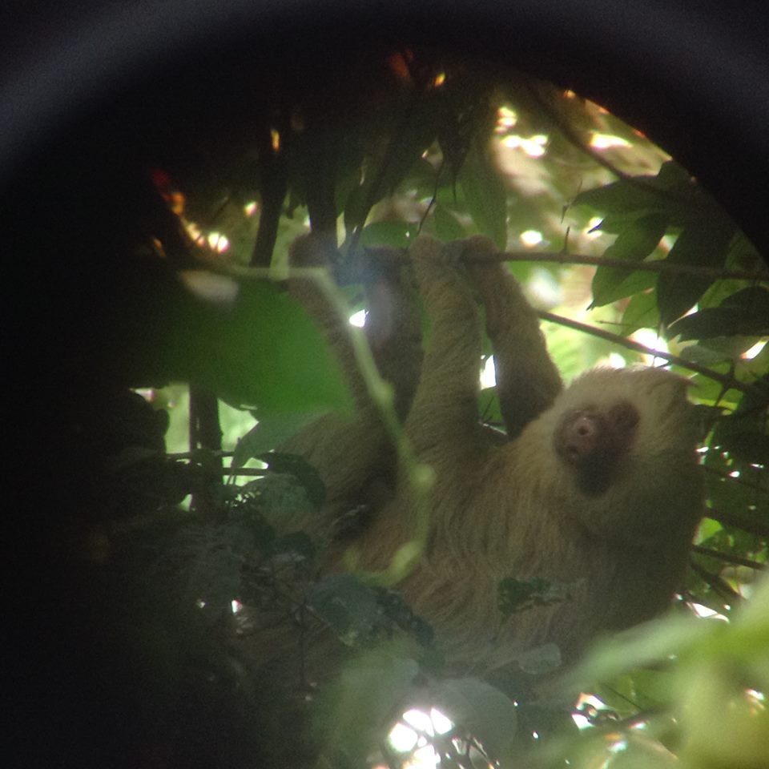

Slide 19
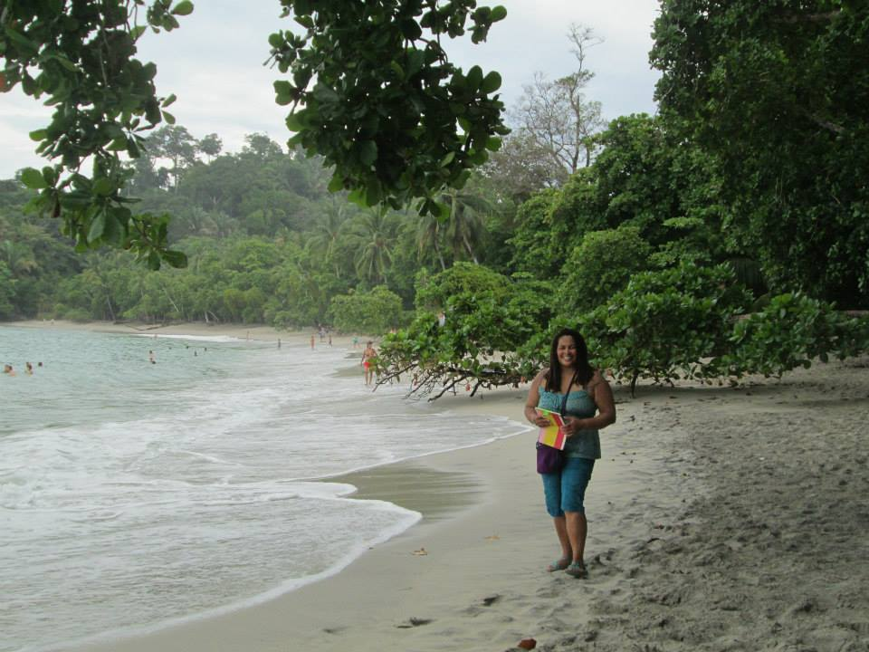

Slide 20
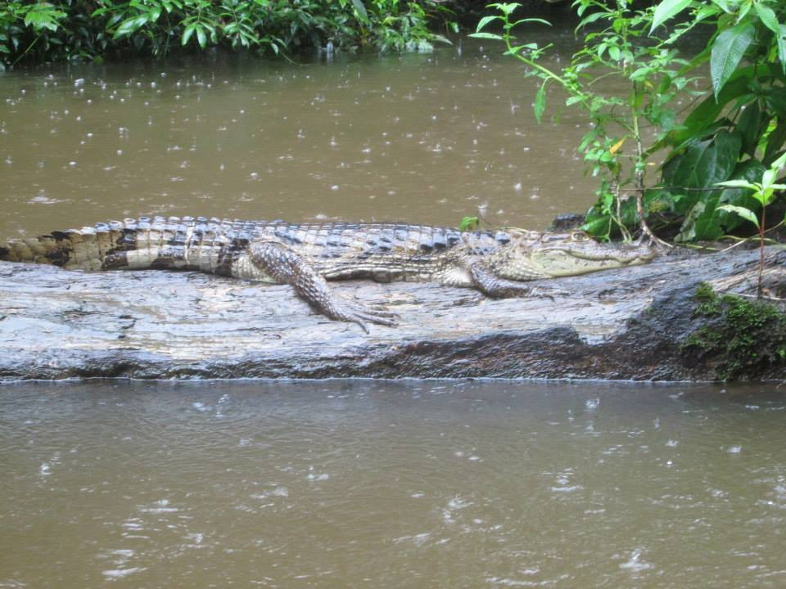

Slide 21
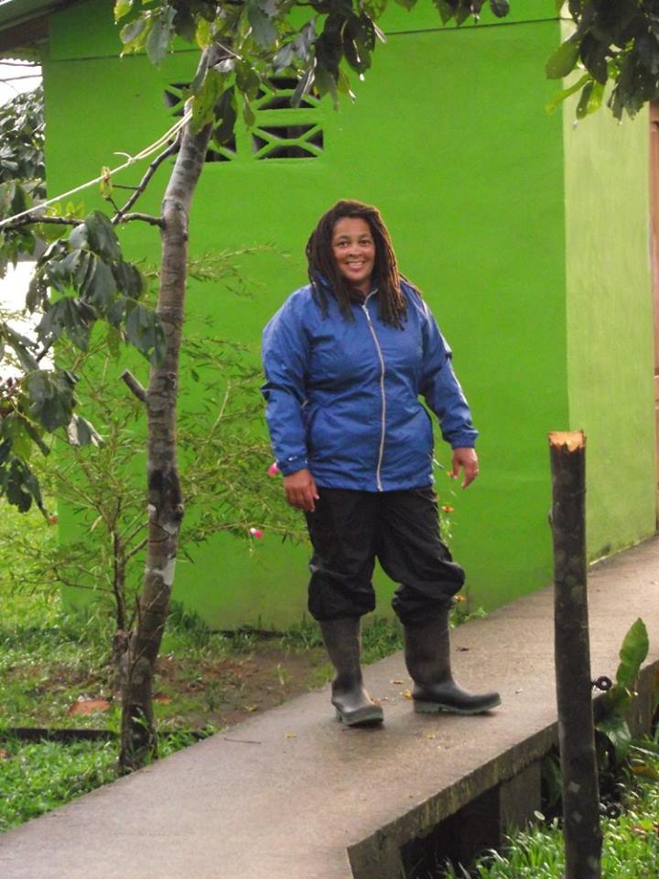

Slide 22
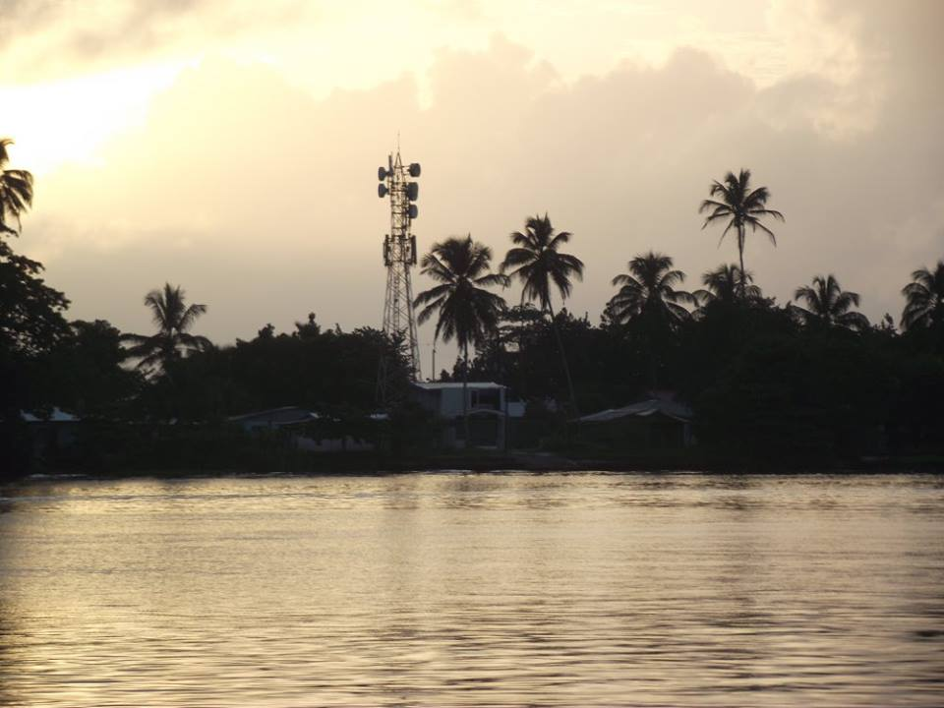

Slide 23
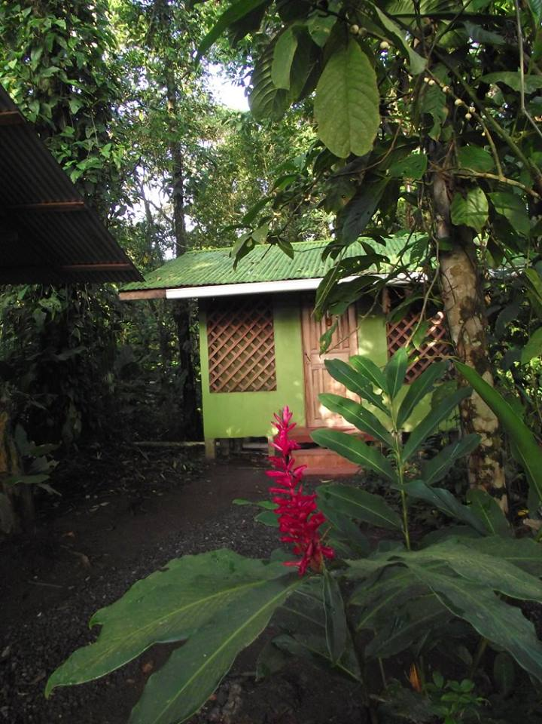

Slide 24
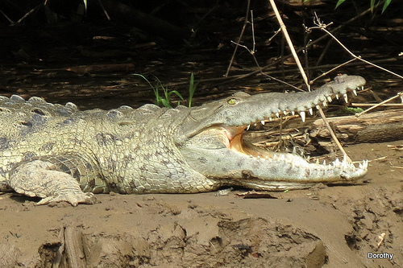

Slide 25
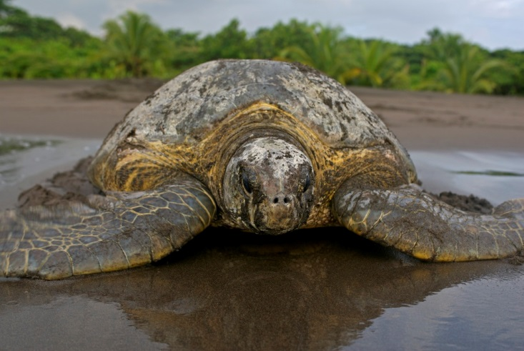

Slide 26
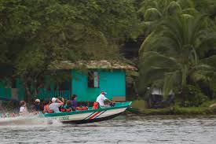

Slide 27
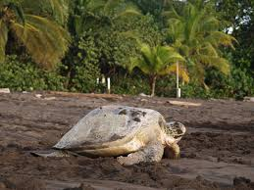

Slide 28
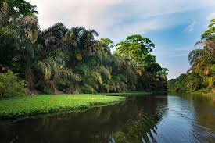

Slide 29
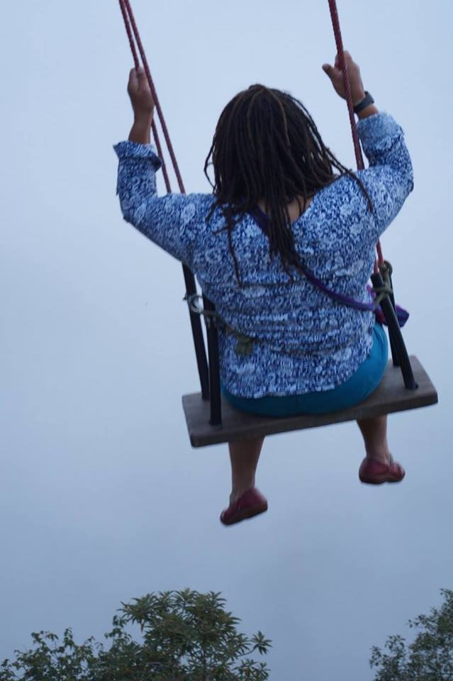
ECUADOR IN AUGUST – DRY SEASON - 75 DEGREES
Ecuador is a country which has fantastic wildlife and lots of wild activities for adults. We stood on the equator, saw the smoking volcano, swung on a swing in the clouds and went white water rafting.

Slide 30
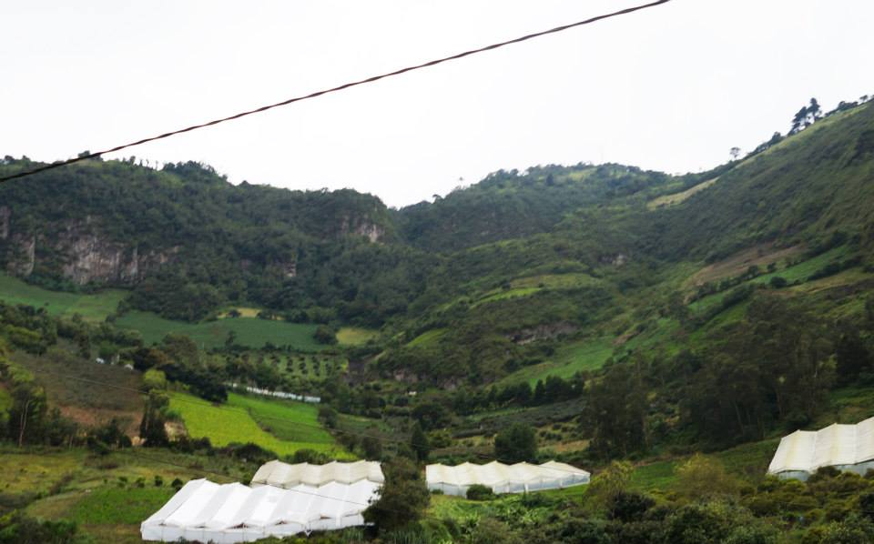

Slide 32
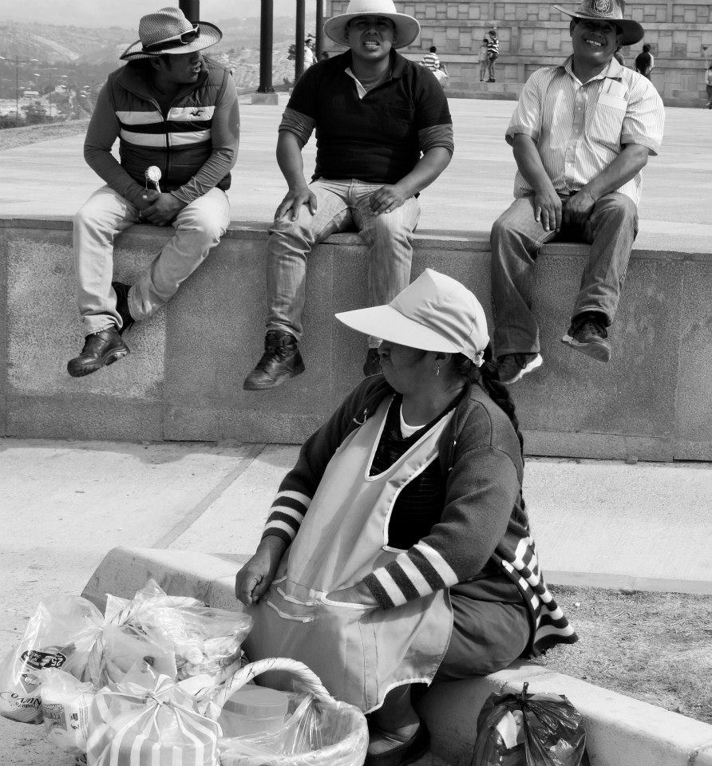

Slide 33
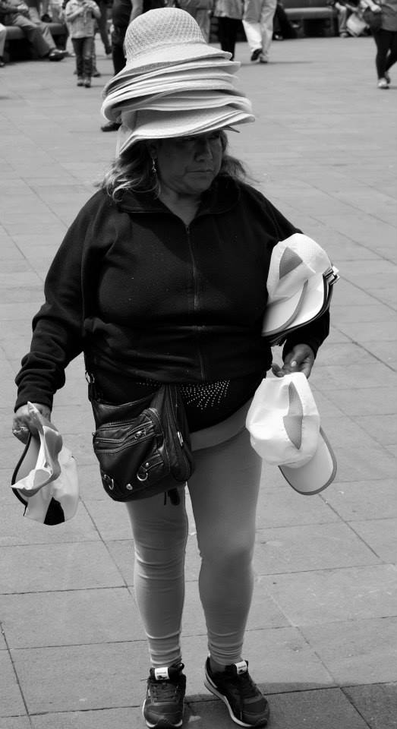

Slide 34
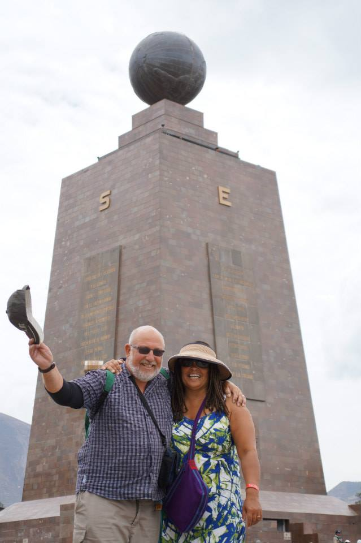

Slide 35
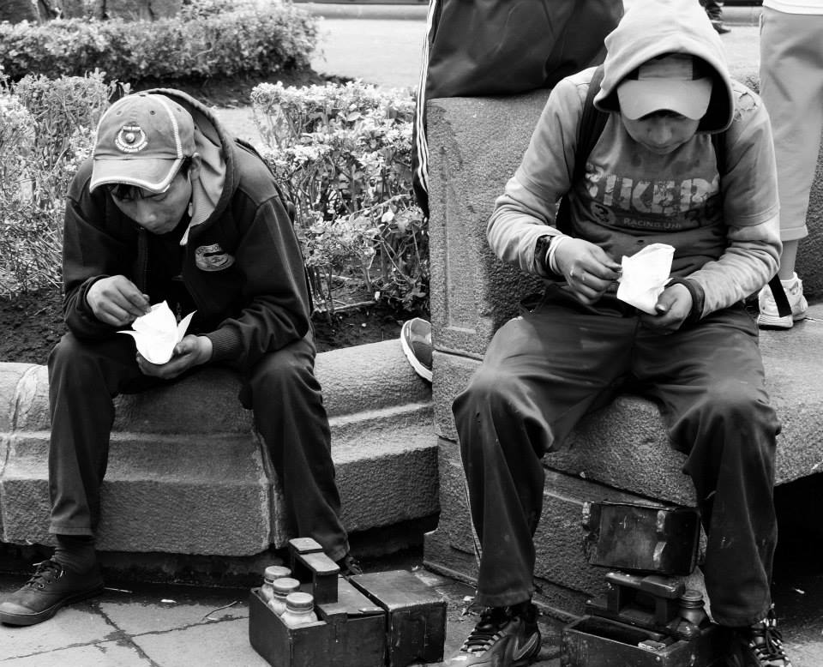

Slide 36
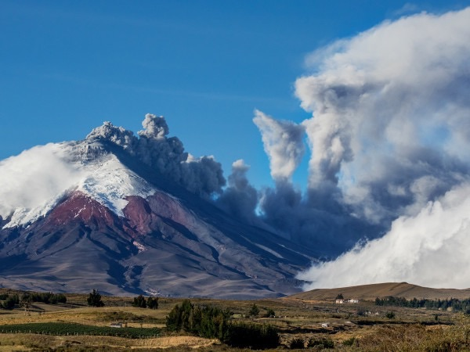

Slide 37
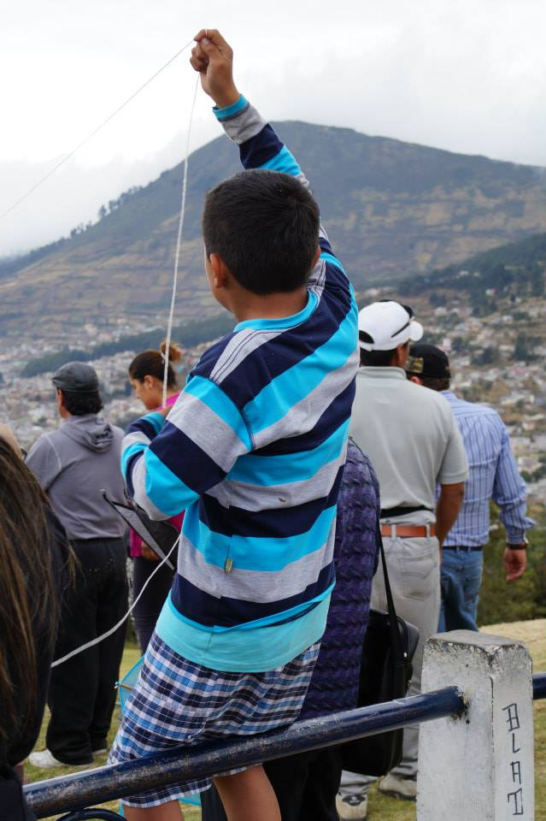

Slide 38
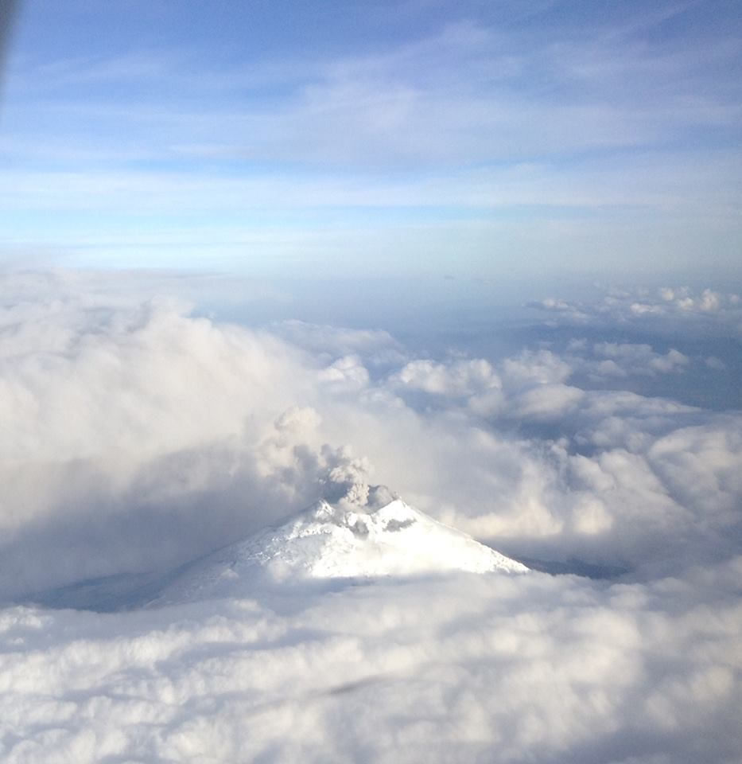

Slide 39
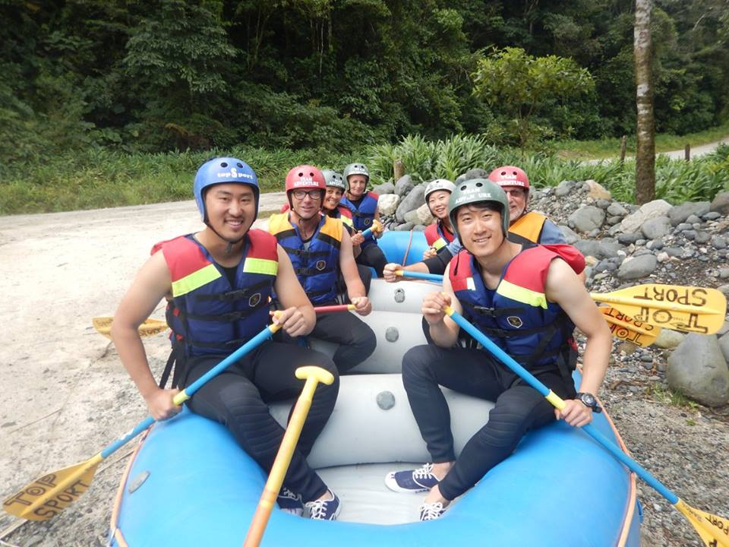

Slide 40
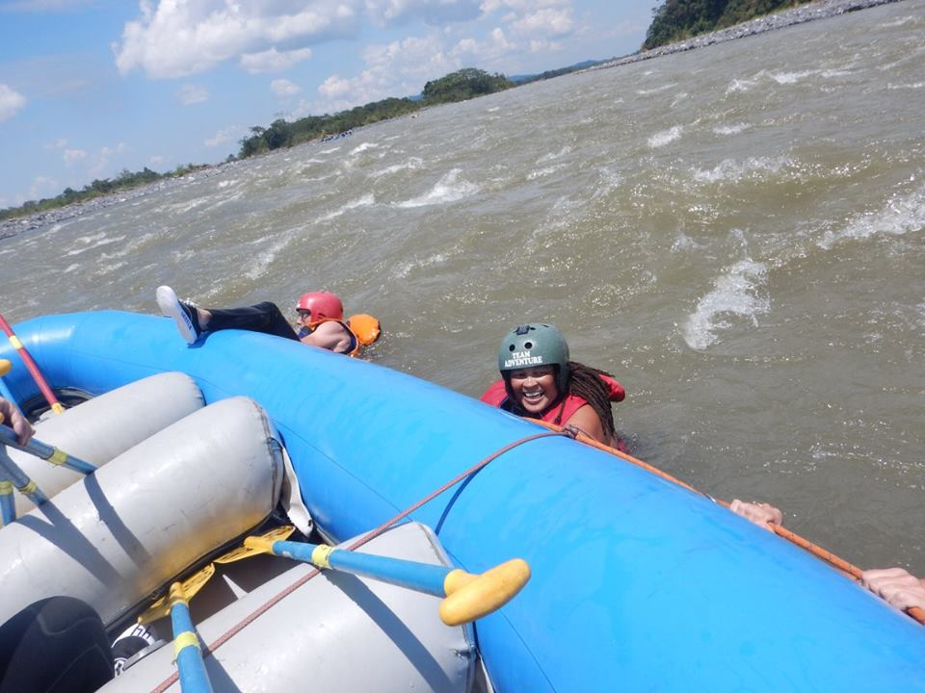

Slide 41
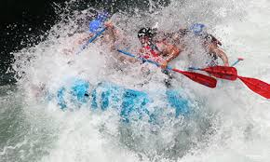

Slide 42
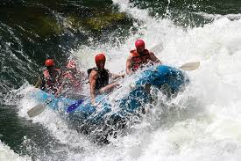

Slide 43
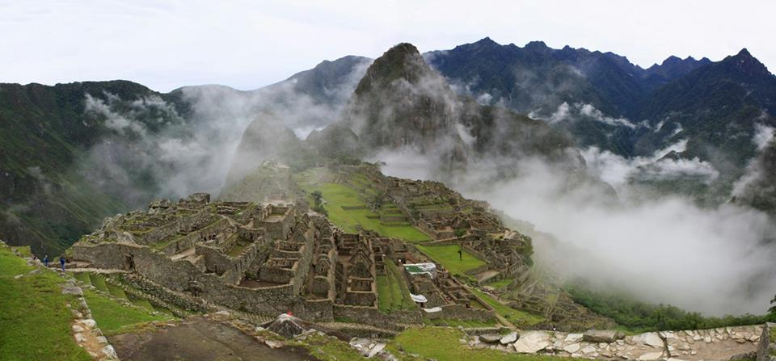
PERU IN SEPTEMBER - SPRING 70 DEGREES
Peru is a very colourful country and Cusco the city where we stayed mostly is very high above sea level and many visitors suffer from altitude sickness. We were lucky enough to see 2 different Christian festivals, we went to Machu Picchu which was once a hidden Inca site, we visited salt ponds and we made chocolate from cocoa beans.

Slide 44
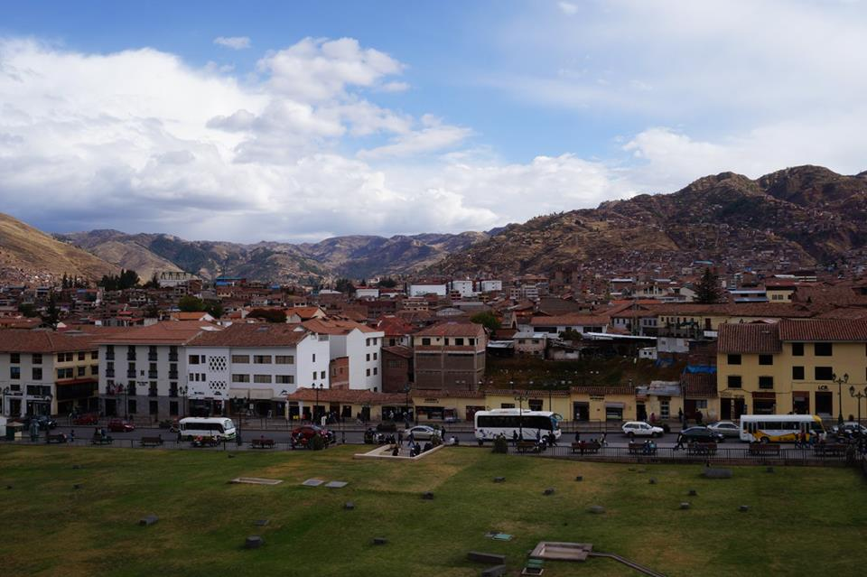

Slide 45
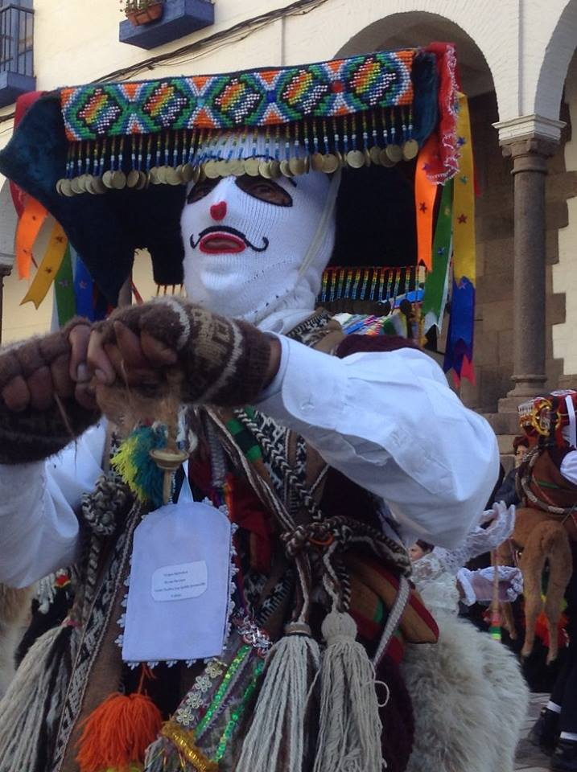

Slide 46
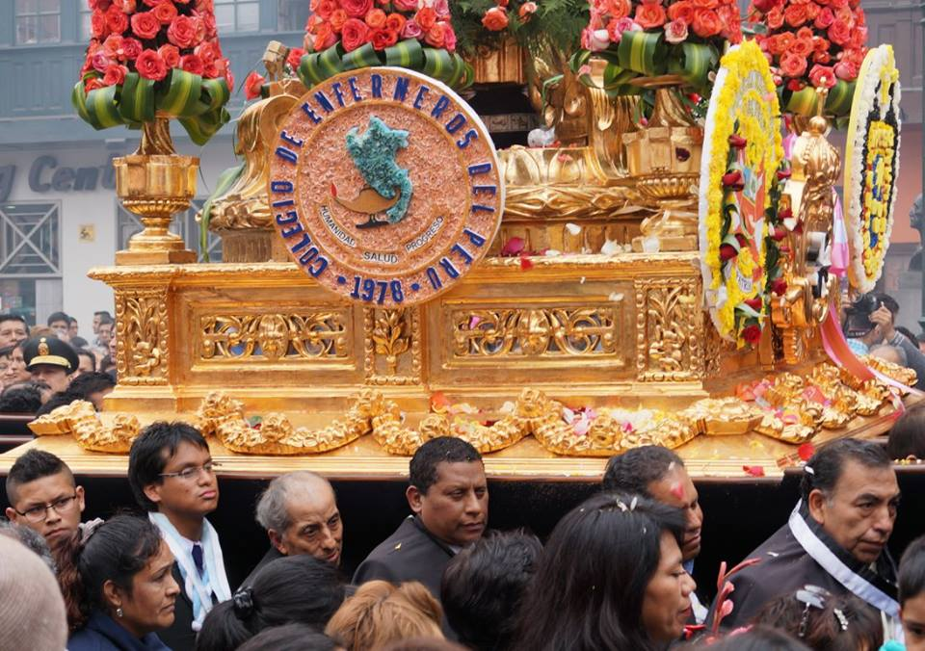

Slide 47
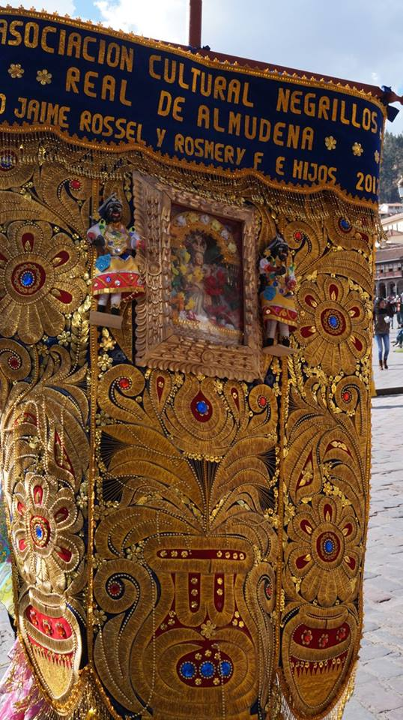

Slide 48
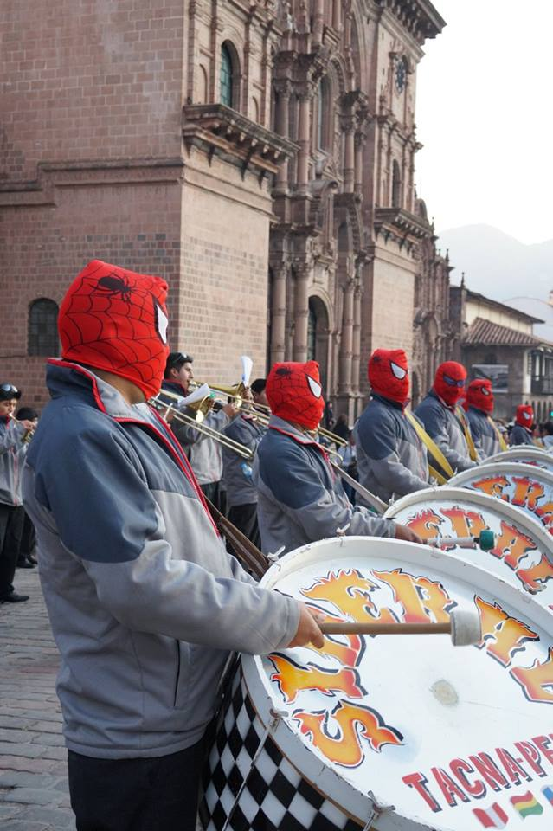

Slide 50
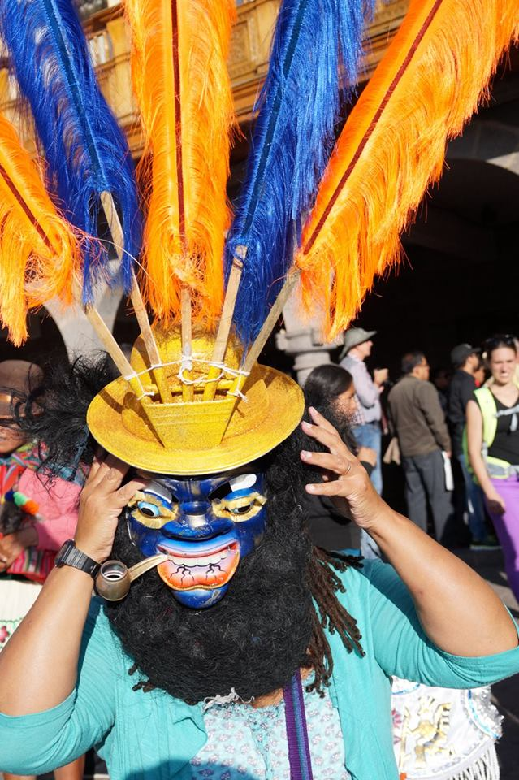

Slide 51
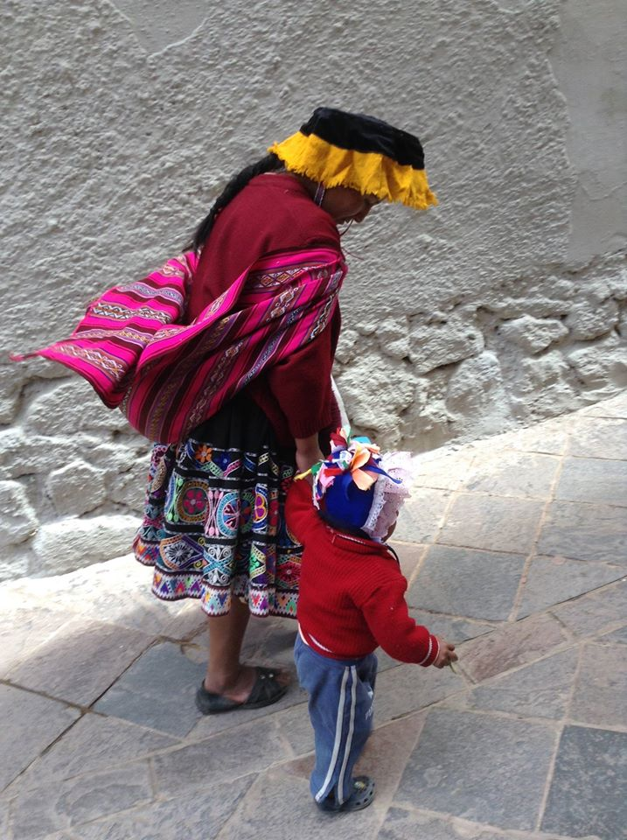

Slide 52
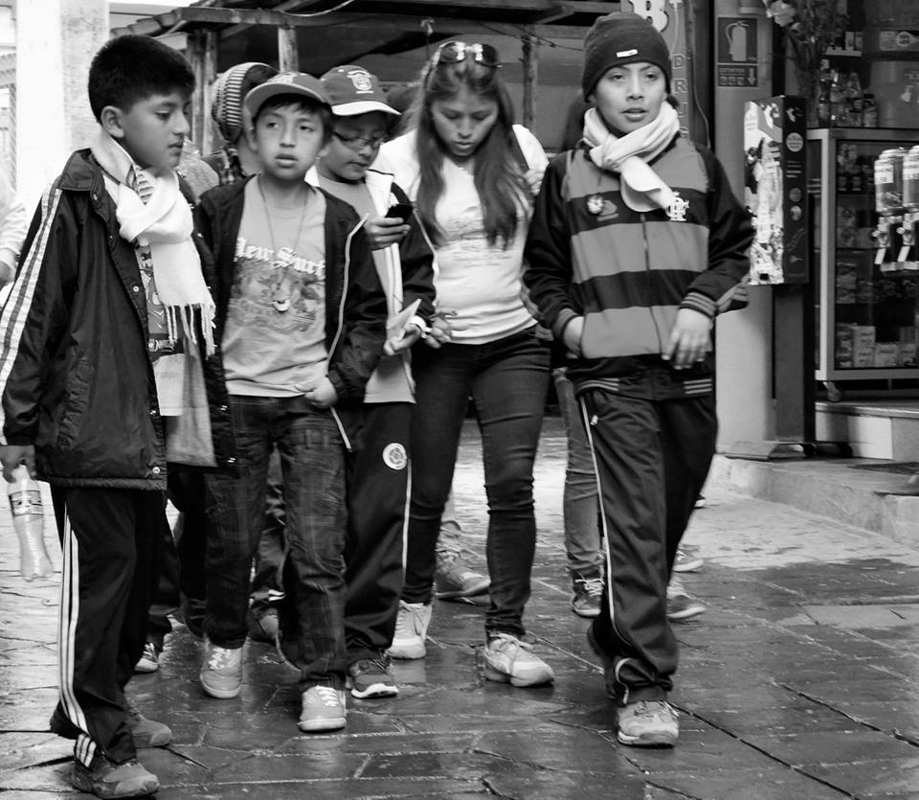

Slide 53
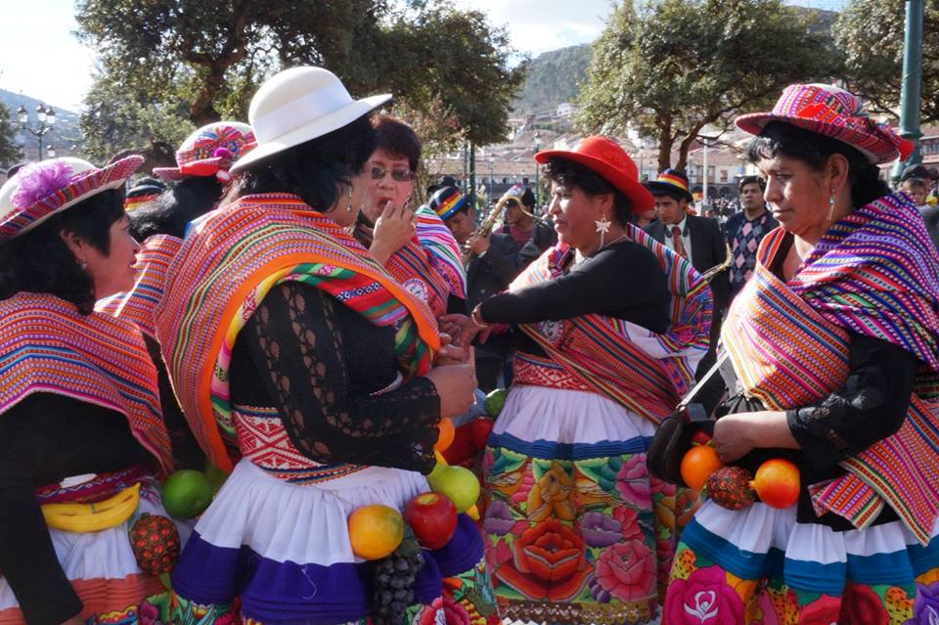

Slide 54
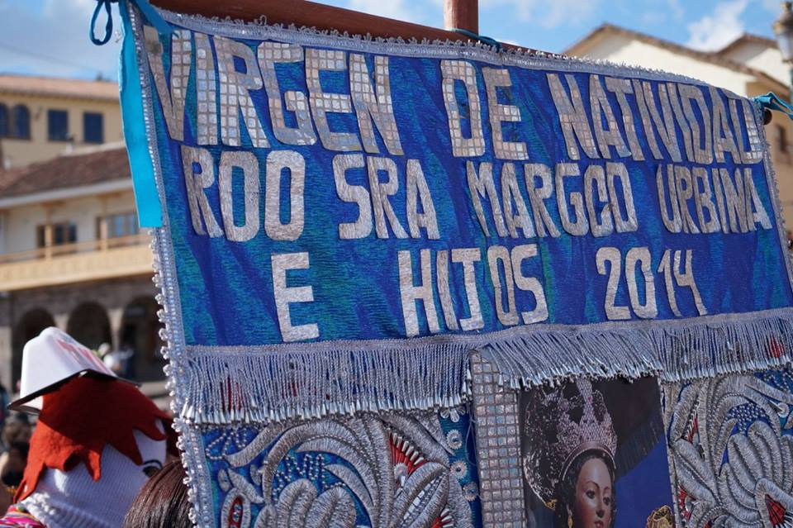

Slide 76
ARGENTINA - SEPTEMBER – OCTOBER – SPRING 65-75 DEGREES
Argentina was the inspiration for the trip. Football, Gauchos, Artists, Tango and waterfalls. We love Argentina. I also met Dhanni, who is a friend’s son, from London who lives there now.

Slide 105
BRAZIL –RIO DE JANEIRO – SUMMER - 80 DEGREES
Rio is the home of the 2016 Olympics. We saw 2 Wonders of the World in Rio. It is a very exciting city dancing, sitting on the beach and listening to music is something that people do every day!

Slide 124
URUGUAY OCTOBER – SPRING - 75 DEGREES
Uruguay is very similar to Argentina. It is a very simple place with a beautiful coastline and wonderful people.

Slide 132
CAPE TOWN SOUTH AFRICA – SPRING 75-85 DEGREES
Marine 5 and The Big 5 were all ready and waiting for us. We loved South Africa and we learnt a lot about its history and its most influential leader Nelson Mandela

