Slide 1
Photo Album
by Paula Shore

Slide 2
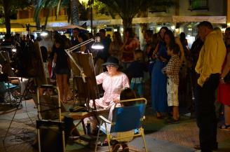
SPAIN IN JULY 2015 – SUMMER – 80-90 DEGREES
A BEAUTIFUL AND FAMILIAR COUNTRY. It was very hot, but we spent most of our time by the sea or in it. The evenings were warm and many people entertained us on the streets.

Slide 3
We love to travel. We have seen the best of man and the worst. We have been challenged and we have often landed softly. What we know for sure is that travel opens our eyes, creates a platform for some interesting and often controversial conversations, but most importantly it changes you for the better. I know we will return armed with something. What that is, we do not know, but we will enjoy the journey whatever it looks like.
Life isn't perfect as we find out on our travels across The Americas. None of the content is meant to offend but if it does - well what can I say?!
We knew many people had been supporting this venture and we had planned this for 2 years we were determined to make the most of it but like any good plan it is open to change!
Link to photos on Facebook Photos- Holiday of a Lifetime 2015 https://www.facebook.com/media/set/?set=a.10206574741675386.1073741850.1476834756&type=1&l=0754cf2cb1

Slide 4
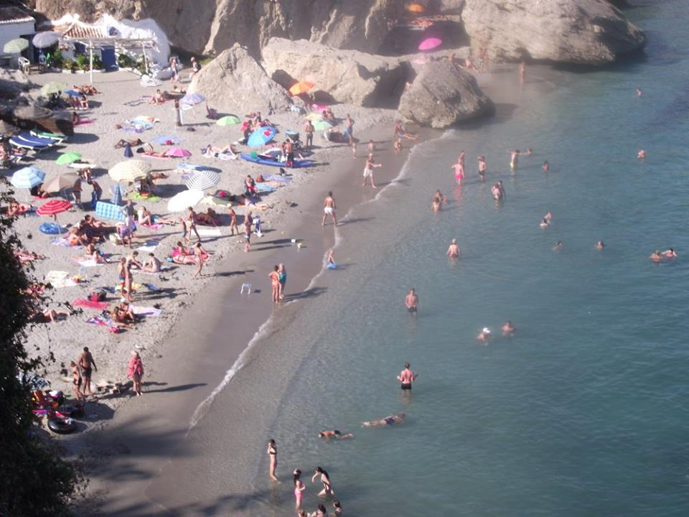

Slide 5
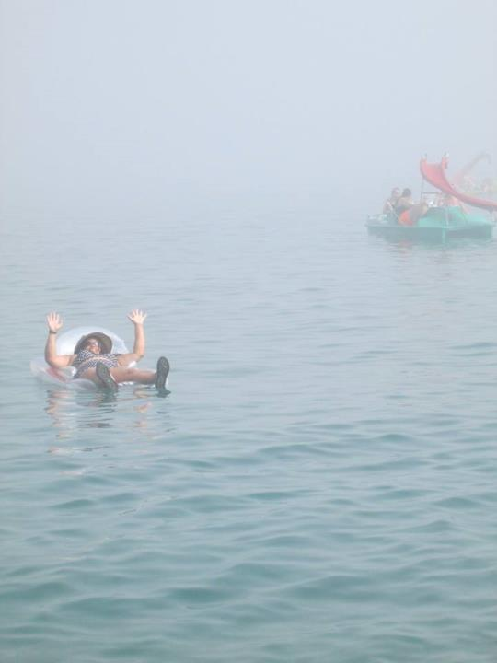

Slide 6
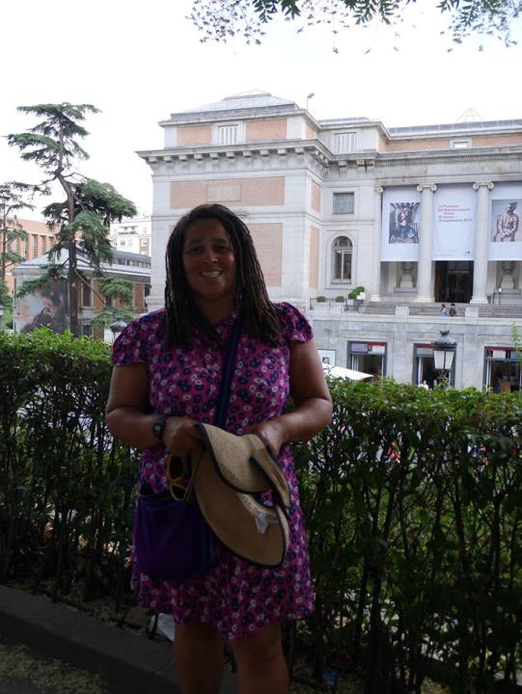

Slide 7
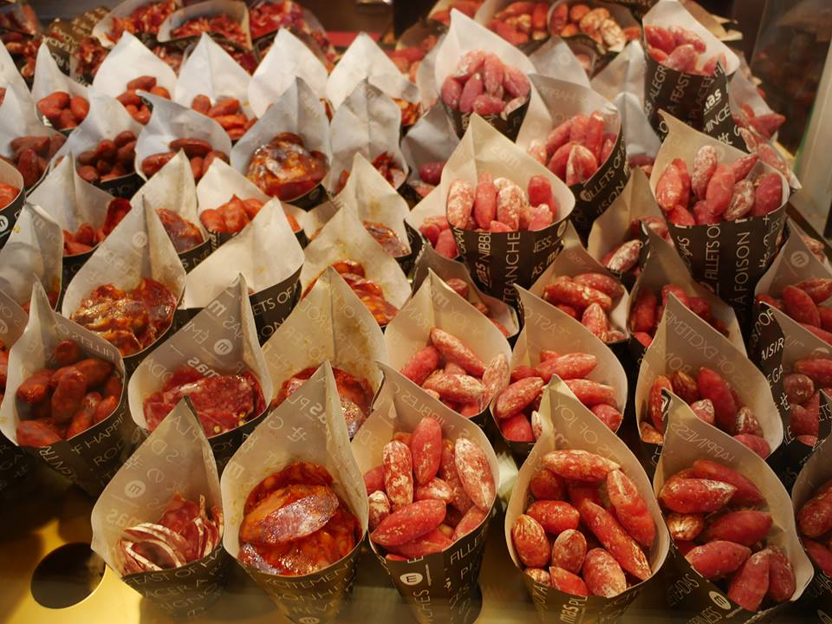

Slide 8
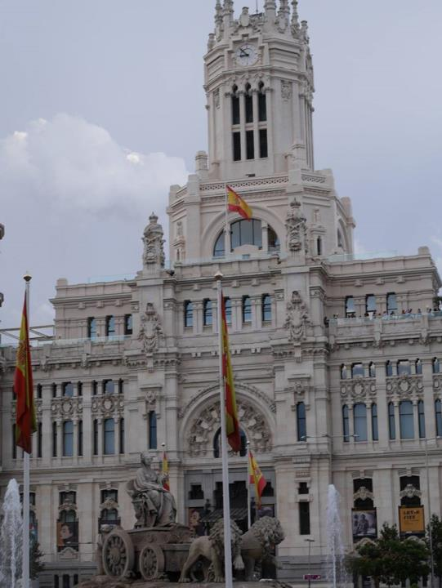

Slide 9
Simply we love to travel. We love new experiences and we love to feel that we connect with those across the lands . Always feeling that we live in a world and not just a city it was time to explore it. The timing couldn’t have been better. The weather on our travels was perfect, averaging 25 degrees but never going below 18 during the day and never above 40 in the hot Spanish sun. Moreover, The Americas is extremely busy in the summer so we had planned to arrive in specific countries to capitalise on the lack of crowds and the weather and make the most of our trip.
So why The Americas and not Asia or Australasia? We had been east on a couple of occasions and there are a variety of complications when travelling there. The countries in The Americas are set up well for travelling. With most countries being poor this often means train, boat and bus travel are cheap and so you can go long distances for pennies and communicating is easier - language, both reading and speaking, is accessible – many people speak English and our knowledge of Spanish was adequate. People are very friendly and humble and there are no complications for a black woman with dreadlocks, other than some friendly curiosity.

Slide 10
There is rarely a need for visas and finally the weather is perfect - no monsoons or hurricanes. So the plan began. We would start in Spain, a familiar place, and relax and if possible begin to hone our understanding of the Spanish language.
Spain was, as ever, hot, dependable and a haven for relaxing. Other than the daily hike up and down ‘cardiac hill’ we just relaxed on the beach and by the pool and soaked up the Spanish sun. Bliss, perfect bliss.
Then onwards to Madrid a ride in a mosquito for a plane and I had a kicker behind me. My Paddington Bear hard stare did nothing to deter them, but hey we landed safely and Madrid revealed its beauty to us. The tour bus was well organised and we used this to get about the city. We loved the San Miguel Market and of course the ambience of the entire city. We welcomed the rain clouds, strolled through the parks and continued to soak up the Madrid culture through Goya’s eyes and that of the others who had put Madrid on the map. Well worth a visit and much quieter than Barcelona. I guess Barcelona has many day trippers coming from Costa Brava.

Slide 11
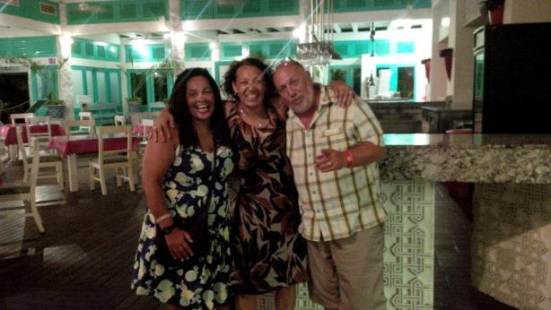
MEXICO – AUGUST 2015 SUMMER - 80 DEGREES
The people were so kind in Mexico. We loved the stories about their history and loved looking at where the ancient Mayans once lived. Mexico had the best beaches. I also met a friend from London who was also coincidentally holidaying there.

Slide 12
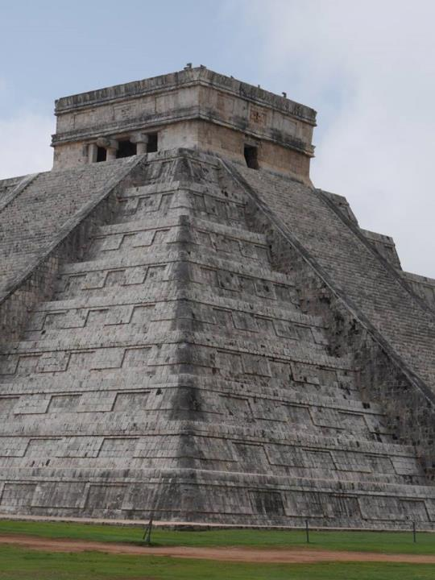

Slide 13
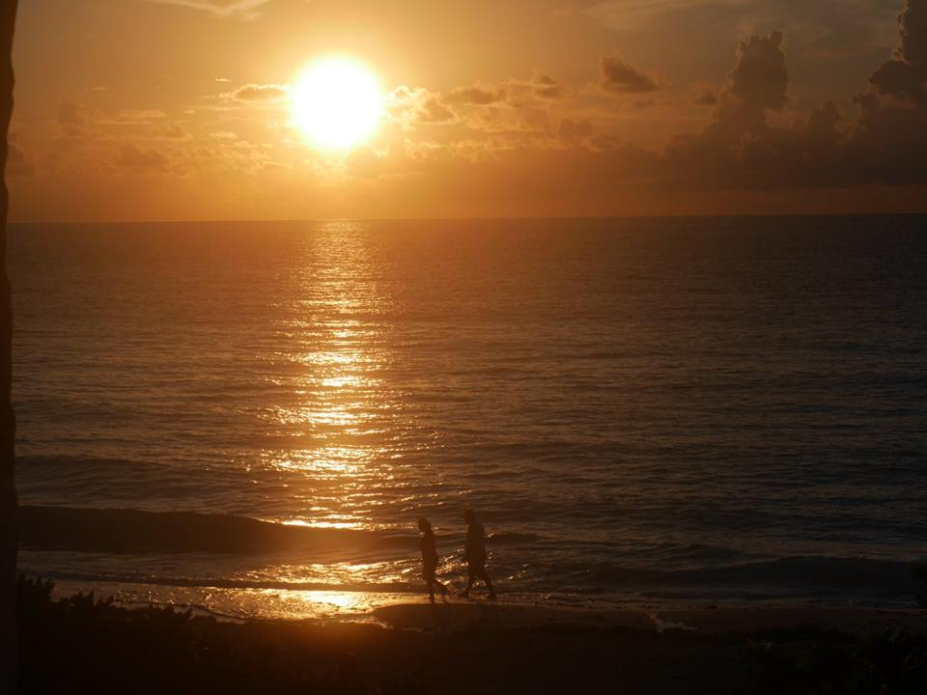

Slide 14
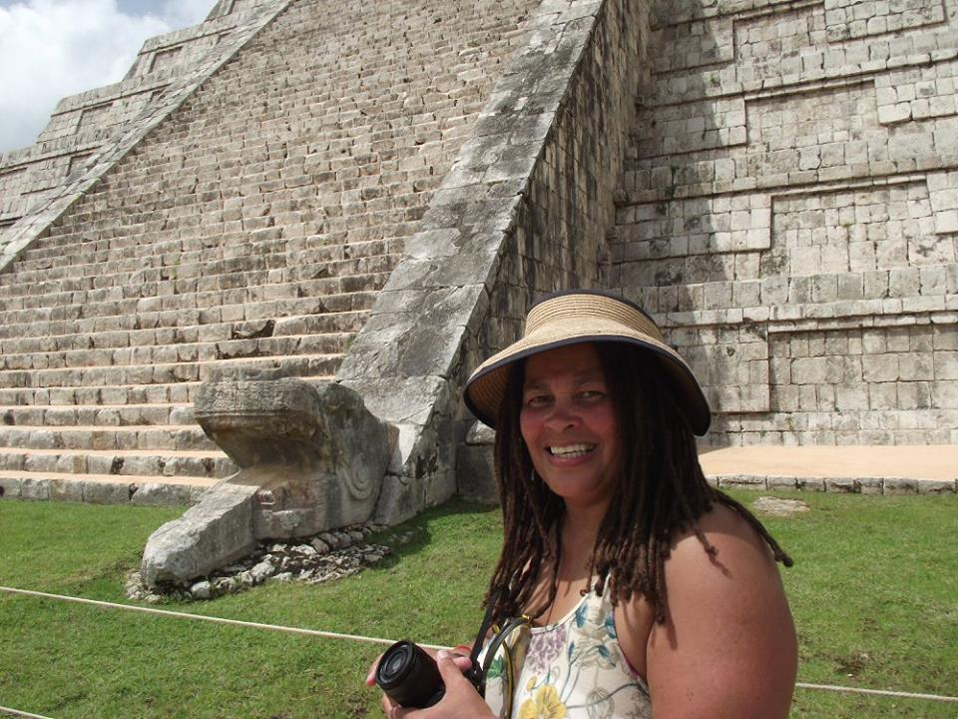

Slide 15
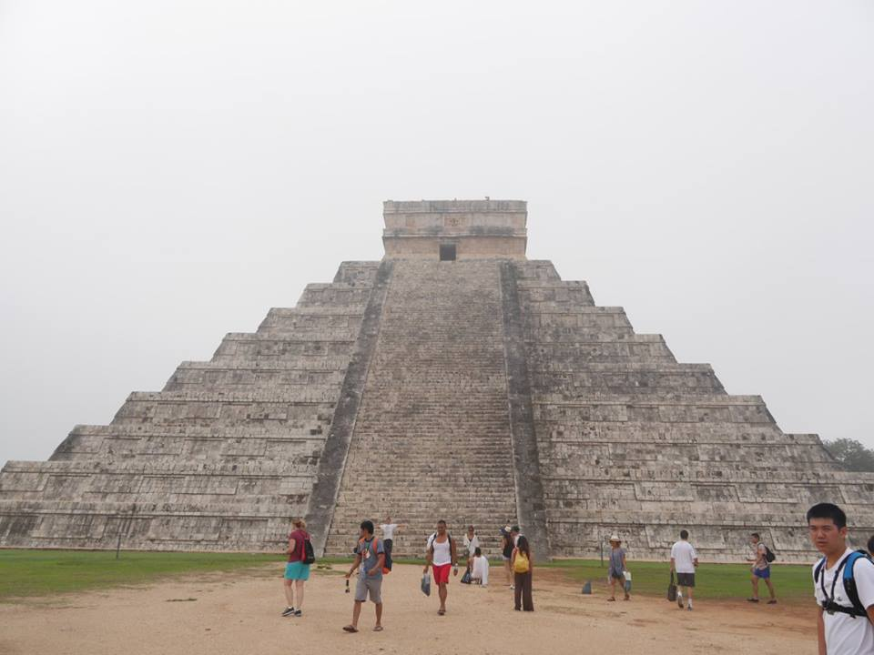

Slide 16
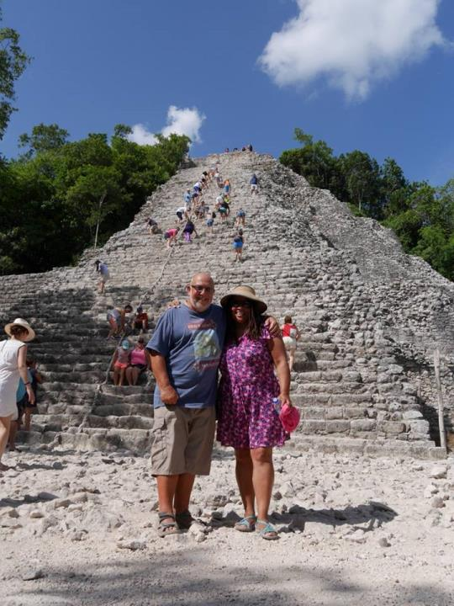

Slide 17
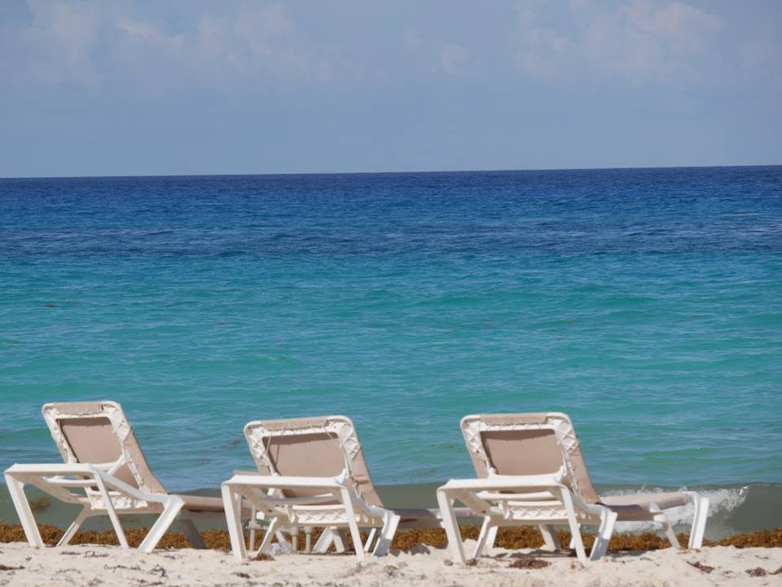

Slide 18
A quick hop over the Atlantic and on to Mexico. I don’t know what I thought Mexico would be like other than hot, but I certainly didn’t expect what was given to us. A beautiful country with such interesting history - you would never be bored and like us I am sure, be inspired. There is something for everyone in Mexico and I think I would recommend it as my number one family destination. The beaches, the resorts, the ease of travel, the safety of Cancun, the history of Chitchen Itza, Tulum, sink holes and Coba were simply breath-taking and finally the people made for an excellent holiday. There were many Americans there.

Slide 19
The Mexicans favoured phrase was ‘It’s my pleasure’ and you really felt that they meant it. They always went the extra mile. Everyone we met was just fab! In addition, I met an old pal from London who I discovered on FB had landed just up the road! That encounter really did put the icing on the cake. The beaches – well what can I say – they are dreamy, really dreamy and so perfect for that contentment that you have been striving for on your holiday. The Mexicans and Americans didn’t use the beaches, most preferring to sit by the pool, so they are quite empty and of course it was turtle egg laying season so there were hundreds of turtles laying their eggs every night. This tranquillity coupled with a light breeze meant that their beaches really are the best I have every visited in the world.

Slide 20
COSTA RICA IN AUGUST – RAINY SEASON - 75 DEGREES
We saw so much wildlife in Costa Rica and spent a lot of time on or in water, including capsizing in a crocodile infested river. Very scary.

Slide 21
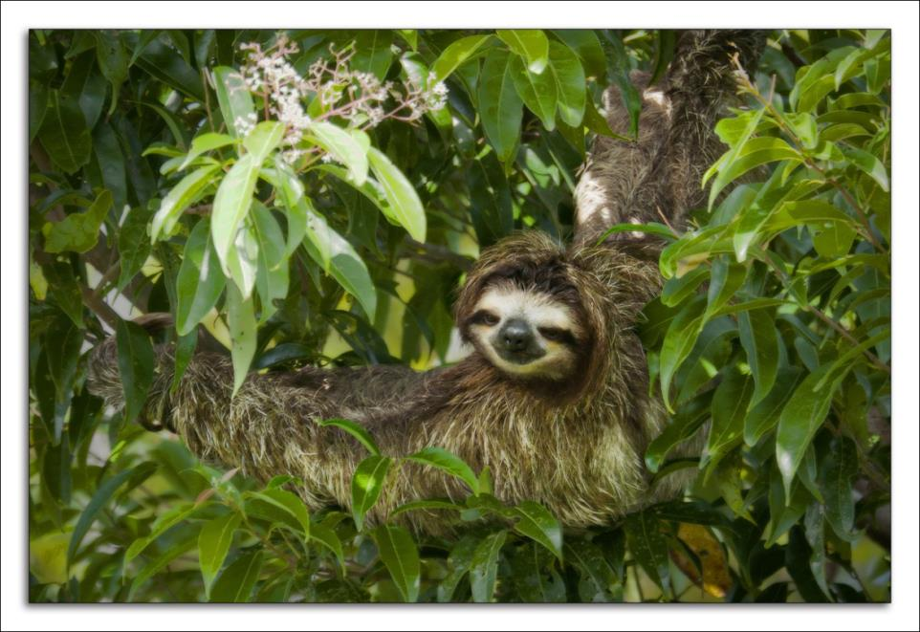

Slide 22
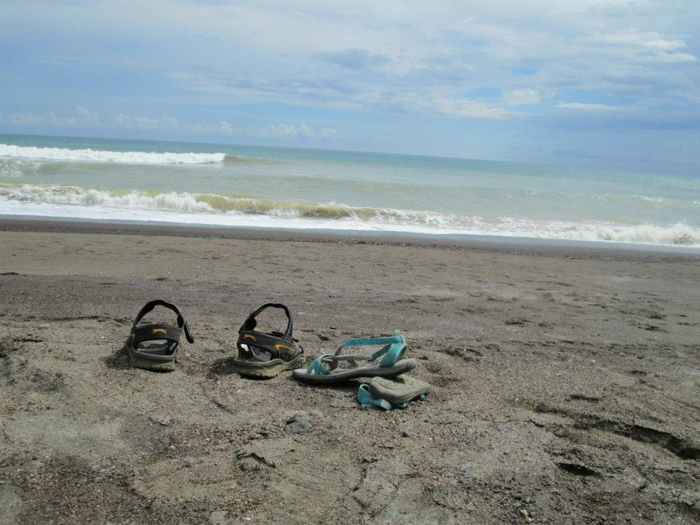

Slide 23
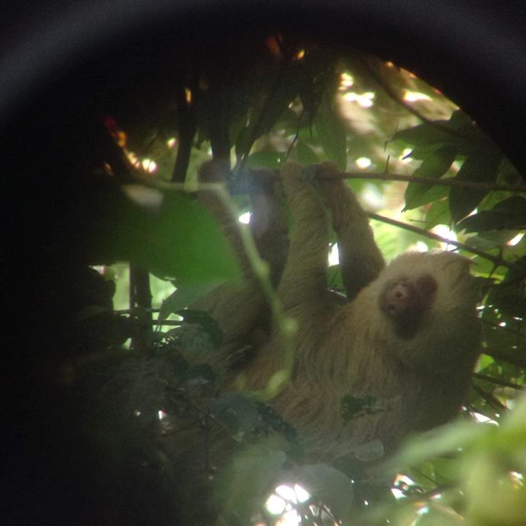

Slide 24
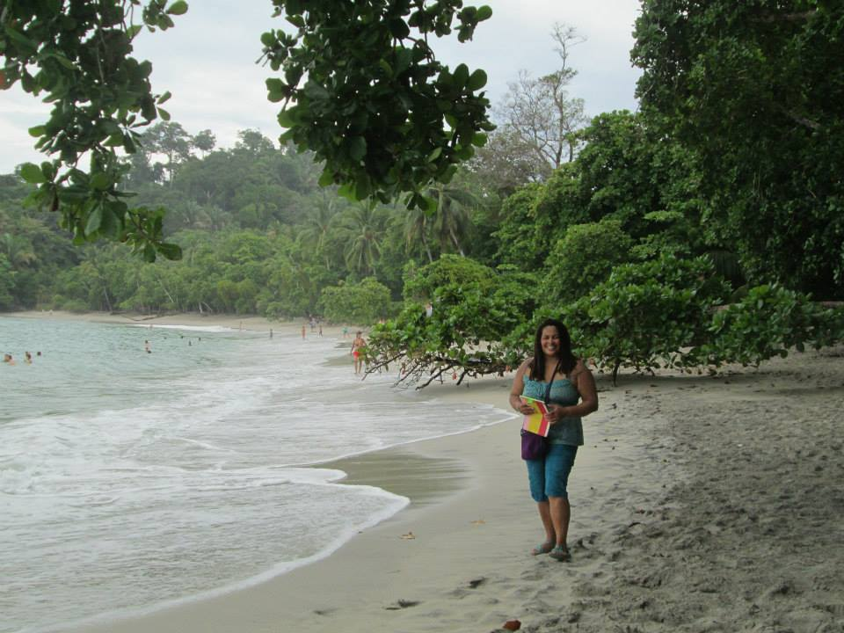

Slide 25
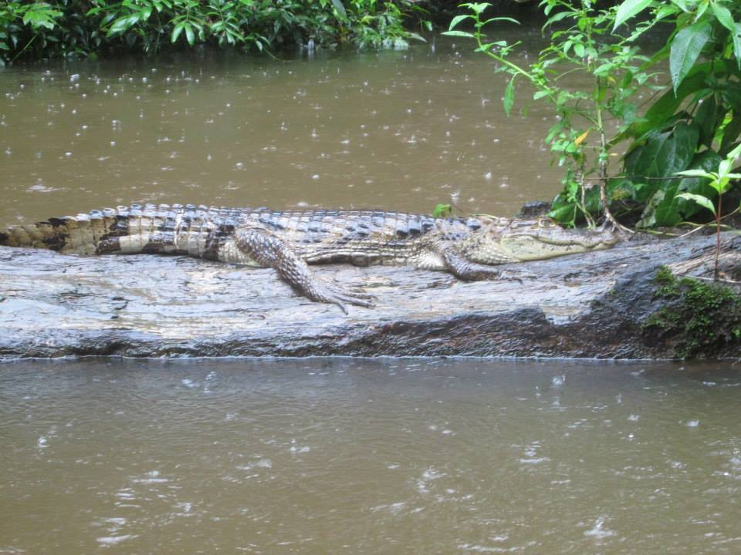

Slide 26
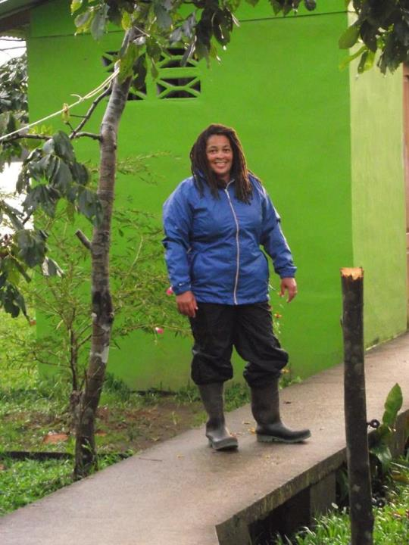

Slide 27
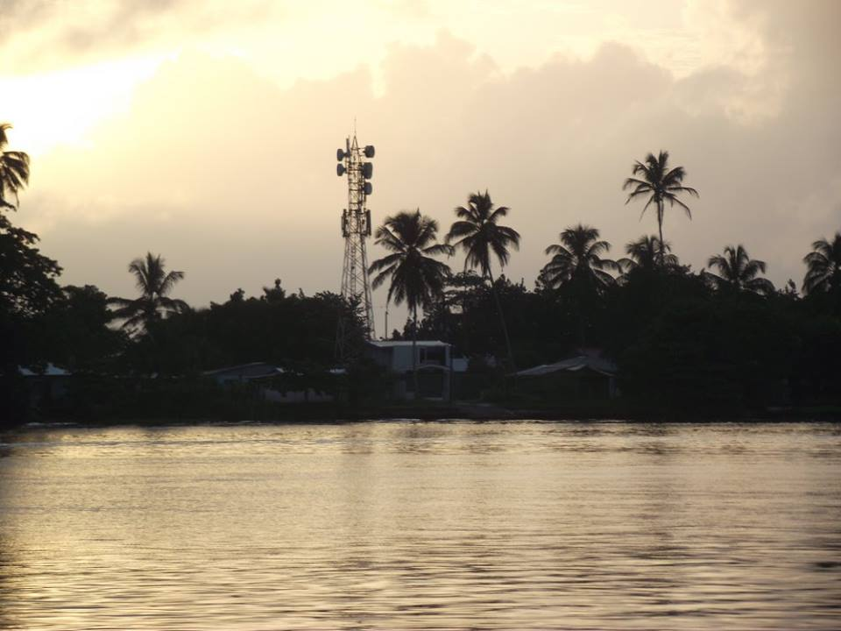

Slide 28
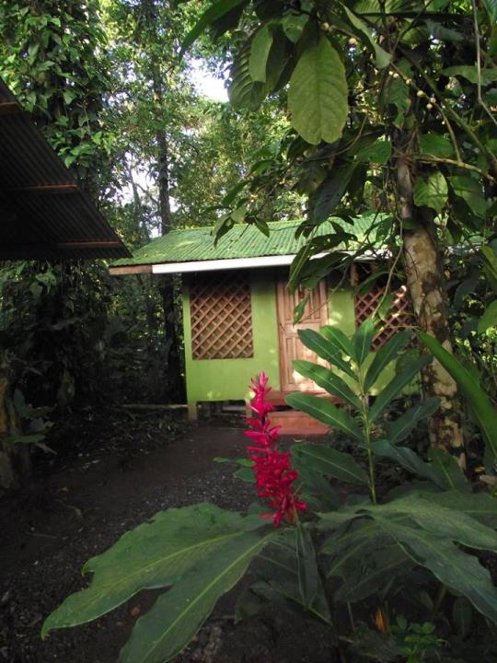

Slide 29
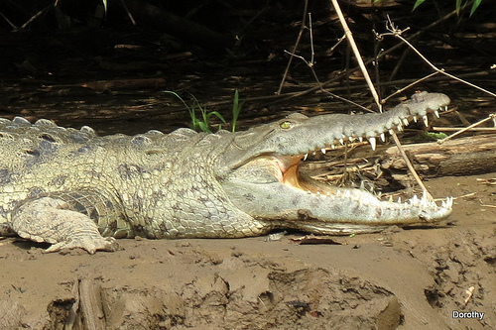

Slide 30
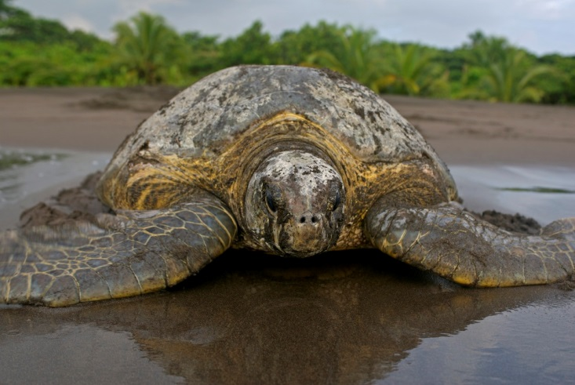

Slide 31
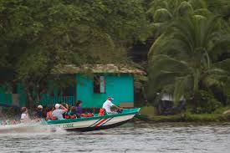

Slide 32
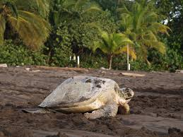

Slide 33
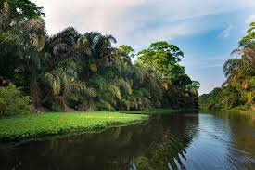

Slide 34
After some drama at the Mexican airport we arrived in Costa Rica where we were to encounter more drama as well as some amazing and thrilling wildlife, some closer up than we had hoped for. Our cabin was deep in the jungle on an island and the only way off the island was by river taxi.

Slide 35
Costa Rica was full of surprises none greater than capsizing in a river taxi with no life vests and 4 Dutch tourists and crocs out ready to eat their morning meal. Believe me it was very scary. We lost all our digital belongings; we were due to go out on a canoe trip into the jungle later that morning we had all our cameras with us. It was one of those moments that you think this isn’t happening; it was so surreal. We didn’t die yes, but the incident marred the holiday and it made me very nervous when near water – the canoe trip and all the other river trips off the island and later whilst on the river above Iguazu Falls in Argentina. We also ended up in a wrangle trying to report it to officials and spent our last day in Costa Rica in the British Embassy. Nevertheless we made the most of our trip and continued with the canoe trip and the turtle watching at midnight. Unforgettable experiences. A must see and do for anyone.

Slide 36
There were to be so many experiences that left us with rambling goose bumps and so very happy to be alive – this was just one of them. Sometimes it was the simplest of things like watching the giant (I mean bigger than my two hands) butterflies flitting around me as I lay in the hammocks scattered around the garden. We had a great Canadian host who really loved CR and it was difficult to leave Tortuguero, but my welfare was too important to stay and so we hotfooted it over to the west coast to Jaco and San Antonio National Park for some more jungle fun. The heat and the mosquitoes had gotten to us, so we welcomed the relief from these for a few days. I spent most of my time just sweating in Mexico unless on the beach and CR wasn’t any easier, but we were prepared for this.

Slide 37
Costa Rica was expensive and a significant number of people were more interested in making dollars than offering a good service, this did dampen our spirits a little, but being in the jungle amongst the wildlife (monkeys, toucans, butterflies, tropical birds, snakes, owls, caimans, turtles, etc) was worth it.

Slide 38
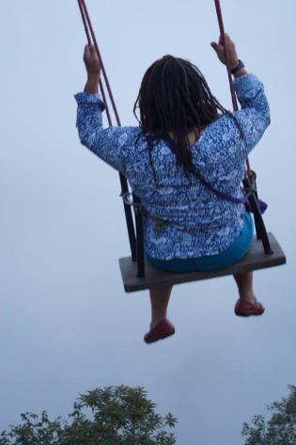
ECUADOR IN AUGUST – DRY SEASON - 75 DEGREES
Ecuador is a country which has fantastic wildlife and lots of wild activities for adults. We stood on the equator, saw the smoking volcano, swung on a swing in the clouds 300ft over a volcano and went white water rafting.

Slide 39
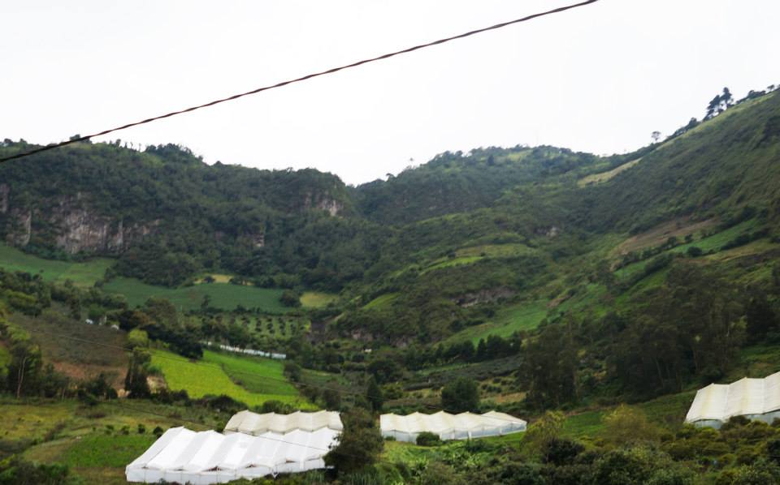

Slide 40
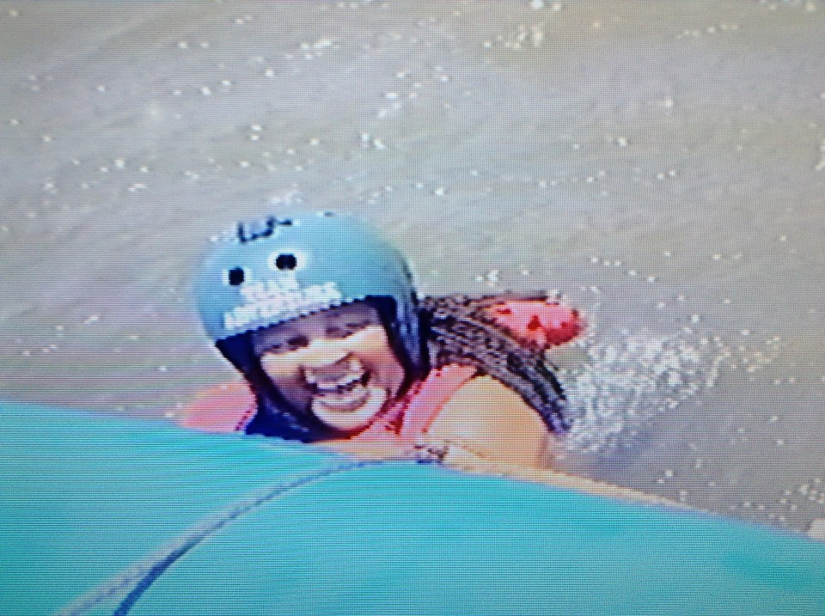

Slide 41
Wetsuits on and the safety talk about the trip started. The language that the instructor used disturbed me - 'when' rather than 'if' was used constantly. When you fall out of the boat...when you get trapped under the boat...when you try to get back in the boat...What is all this 'when...'? I asked myself.' What happened to if...?' What the instructors didn't know was that he was dealing with two potentially paranoid people here and to top it all the Dutch were assigned to the same boat as us - rewind to river accident and our now Dutch friends!
When he started talking about anacondas and crocodiles in the river I was ready to swap my wetsuit for my shorts and top! 'Only joking,' he says!

Slide 42
At times our boat would soar at least 10 ft into the air for about 20 seconds as we grappled with our paddles to get the boat under control. The Koreans remained excitable and rocked the boat further, hoping it would flip, it was a buttock clenching moment for some, but we remained calm as we wiped water from our eyes and high fived each other when we were successful - successful = we had remained on the boat intact.
I began to relax as I saw other boats in the water flip on their sides and all inhabitants ousted, but survive. How bad can it be? I thought. If you have every been white water rafting you will know that you have to sit on the side of the boat and lean towards the water, then lean forwards as you dig your paddle in and lean backwards as you pull your paddle back. This motion naturally means that you are likely to fall out of the boat if you get hit unexpectedly by a rapid wave. Whilst I was vulnerable on the side of this rubber dingy, my confidence grew.

Slide 43
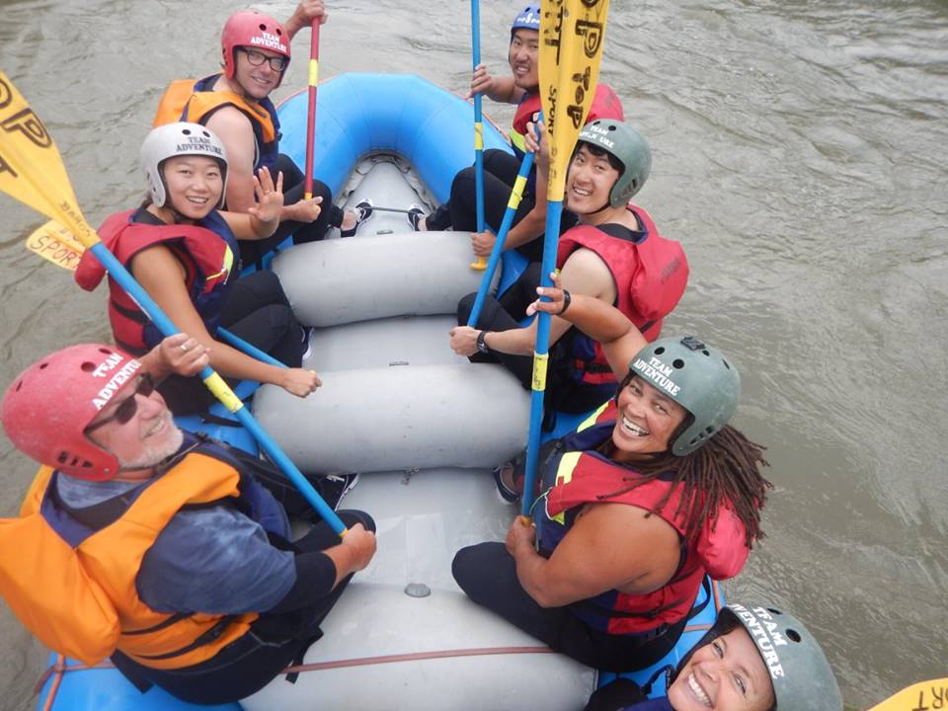

Slide 44
A calm before the storm was on the horizon, just like our holiday thus far. One of the Koreans turned to Paulo the instructor and said, 'I want more action!' 'We are a team, replied Paulo, and these old people do not want more action.' He then turned to us and apologised for calling us 'old'. If it meant I would live to tell the tale of the white water rafting I don't mind being called old. I am old and so is John - well older! 'But if you want more action, Paulo continued, I can give you more.' We entered further Rapids and it was obvious that they were growing with intensity. Paulo always gave good instructions as he skilfully guided us through what were many hair raising moments. We passed by some whirlpools which would suck any unsuspecting adventurer in and release them a different person! I gulped when I saw those hoping Paulo wouldn't take us anywhere near them. Paulo gave us 'oldies' at the back a mischievous wink. He shouted at the Korean to get out of the boat. At first the Korean dismissed his request and stayed firmly put, clutching his paddle and I daresay other parts of his body too! Paulo grabbed him with his large brown paws and threw him into the water. Have you ever seen someone nearly drown, cry for help, look terrified, but pretending that they are ok? Have you ever seen a brown man turn white before your eyes? We did! I can't say it was fun, at the time I was terrified for him, clasping my mouth with my eyes agog and almost letting my paddle slip. The whirlpools sucked him down and down and spat him out time and time again. He gasped for every breath hoping it wasn't his last. Too tired to wave his arms to say help me, help me, he used his eyes to do the talking. Compassion saved the day and United Nations came together to save him from the rushing waters. Like any good Korean citizen he thanked every one of us for forgiving him for his foolish ways and relieved sat down and behaved from then on!

Slide 45
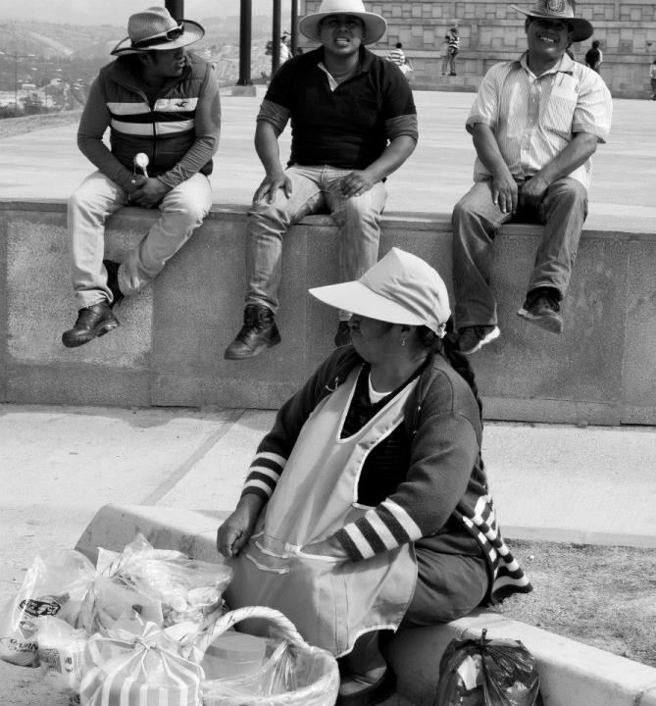

Slide 47
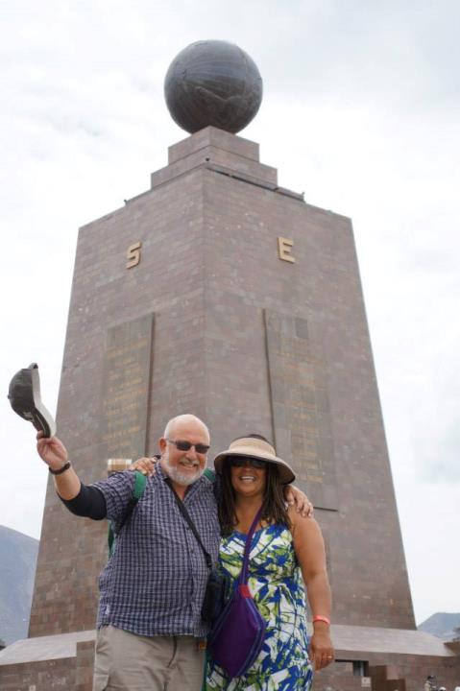

Slide 48
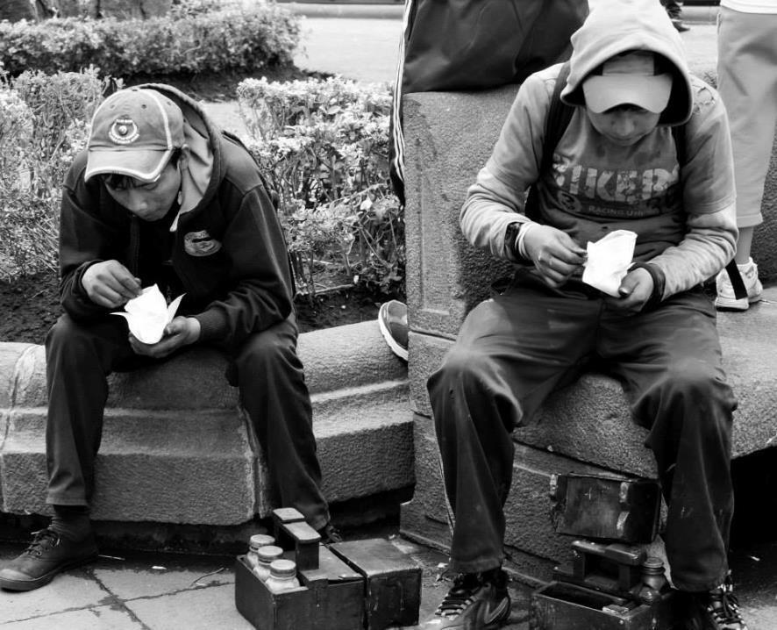

Slide 49
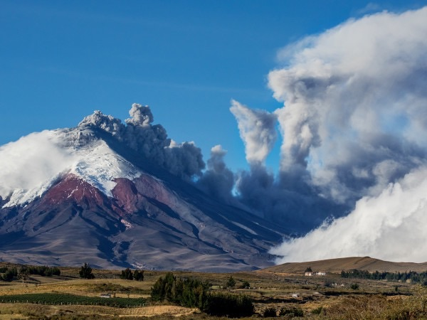

Slide 50
Our first night in Ecuador was a comfortable one. We had been collected from the airport by our host, who was a Dutchman. The room was amazing, just on the outskirts of Quito. We woke up and started to prepare for our travels around Ecuador. We had not planned where to stay or what to do, but hoped to be guided by the locals - ever the optimist and risk taker. By the end of the week we would have visited several churches, Quito landmarks, an art gallery by the nation's most famous artist Guayasamin, seen football matches, polo matches, wathced a kite flying competition, stood on the equator, watched volleyball matches, seen at least two local bands, watched tropical birds fly, seen 2 parades - one including seeing the president, went white water rafting, swung on a swing in the clouds above Banos City, sat in the natural warm spring waters of Banos and prepared for a 40km bike ride! Was that enough entertainment? No, John wanted to go horse riding, but I put this on hold for one of the horse capitals of the world - Argentina!

Slide 51
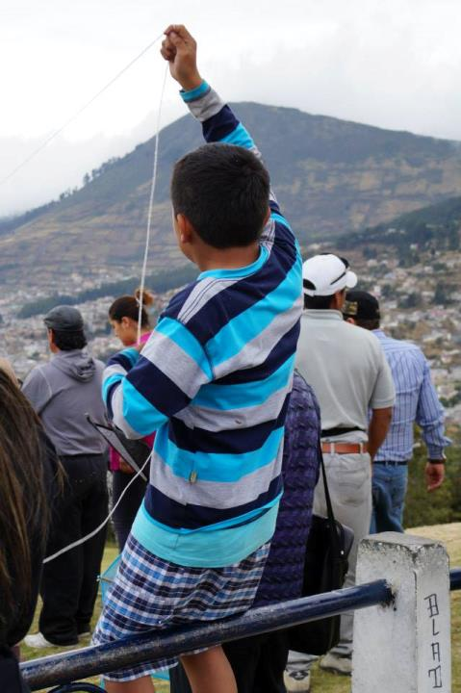

Slide 52
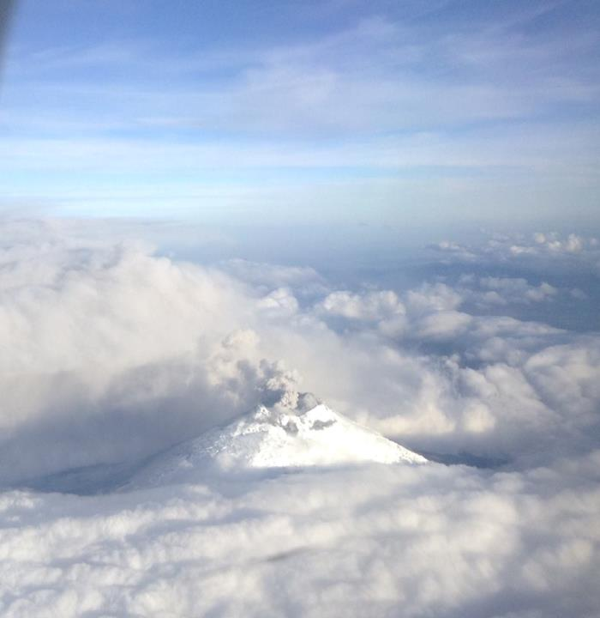

Slide 53
For 140 years Cotopaxi, Ecuador's biggest volcano, had lay dormant, but it decided to wake upon hearing that we were visiting. It spewed its contents 12 km up into the air and has yet to stop, covering Quito and our dreams of a visit to its base in dust! We would later see the damage it had showered on the surrounding area for

Slide 54
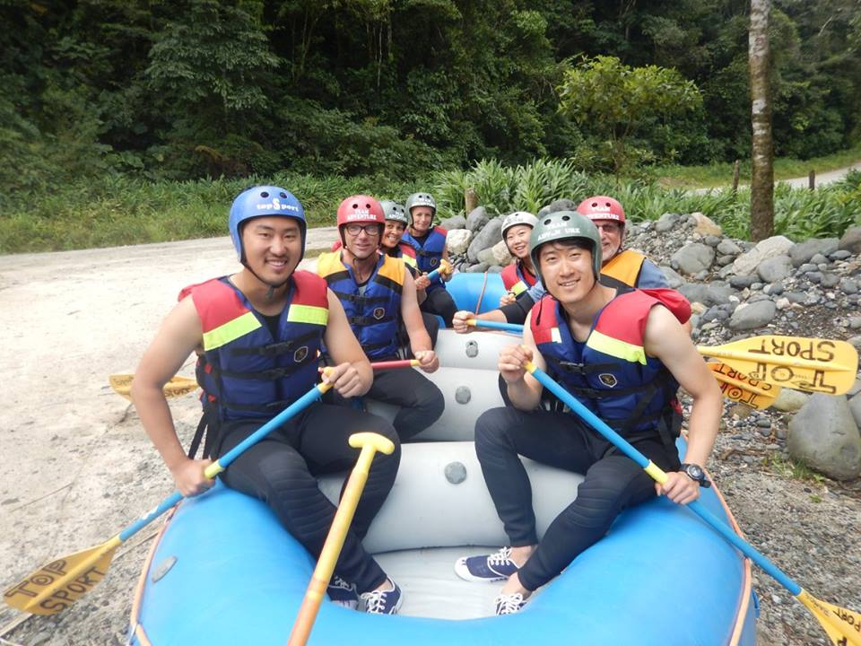

Slide 55
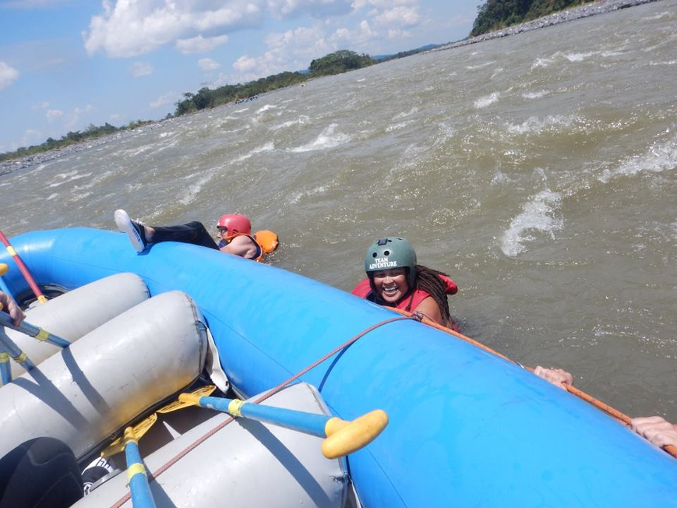

Slide 56
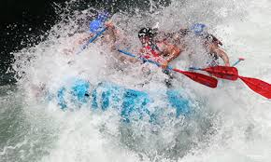

Slide 57
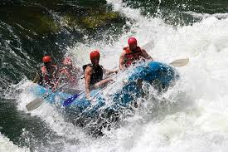

Slide 58
Ecuador was a pleasant surprise. A beautiful country with a constant temperature of around 24 degrees, it was growing in confidence and offered something unique to us. Travelling isn’t just about taking something from a community for your own gratification it is also about giving something back. I would like to think we did this in Ecuador and on our visit. We put places like Ecuador on our map and we tried hard to be part of the local scenes and be respectful of customs and their norms. Ecuador would never have been considered by us as a playful place until we visited it. It had many attractions including the hills, the low clouds, the people, the access to the country, volcanoes, wildlife, entertainment, art, bars, restaurants, sports, outdoor pursuits and the hot chocolate. The list was endless, a real adventurers’ paradise was to be found in Ecuador.

Slide 59
We stayed in 2 parts of Ecuador, Banos in the south offered many outdoor pursuits and we did do some white water rafting and Quito in the north and on the equator. Whilst there Cotapaxi had been smoking although it had yet to blow its top. It lay a thick layer of ash across the land devastating the crops and making the immediate area uninhabitable. The vision of seeing this long time dormant volcano gently smoking from the skies was again a memorable experience.

Slide 60
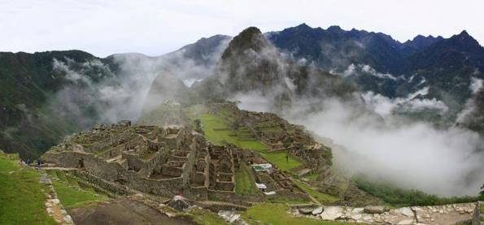
PERU IN SEPTEMBER - SPRING 70 DEGREES
Peru is a very colourful country and Cusco the city where we stayed mostly is very high above sea level and many visitors suffer from altitude sickness. We were lucky enough to see 2 different Christian festivals, we went to Machu Picchu which was once a hidden Inca site, we visited salt ponds and we made chocolate from cocoa beans.

Slide 61
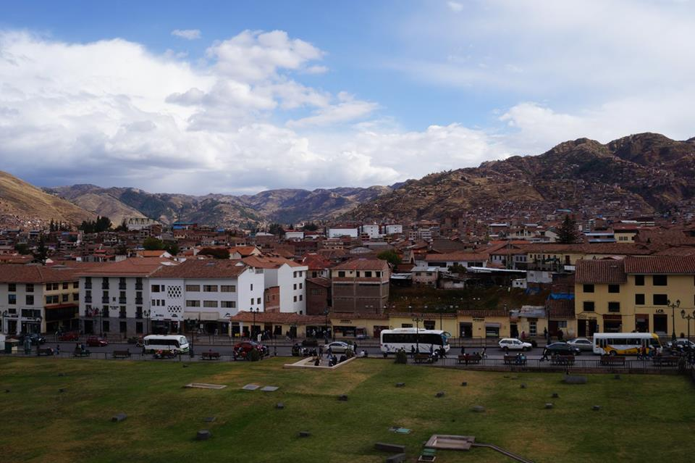

Slide 62
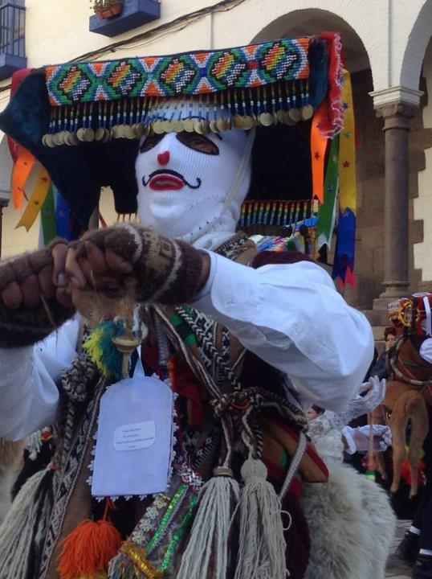

Slide 63
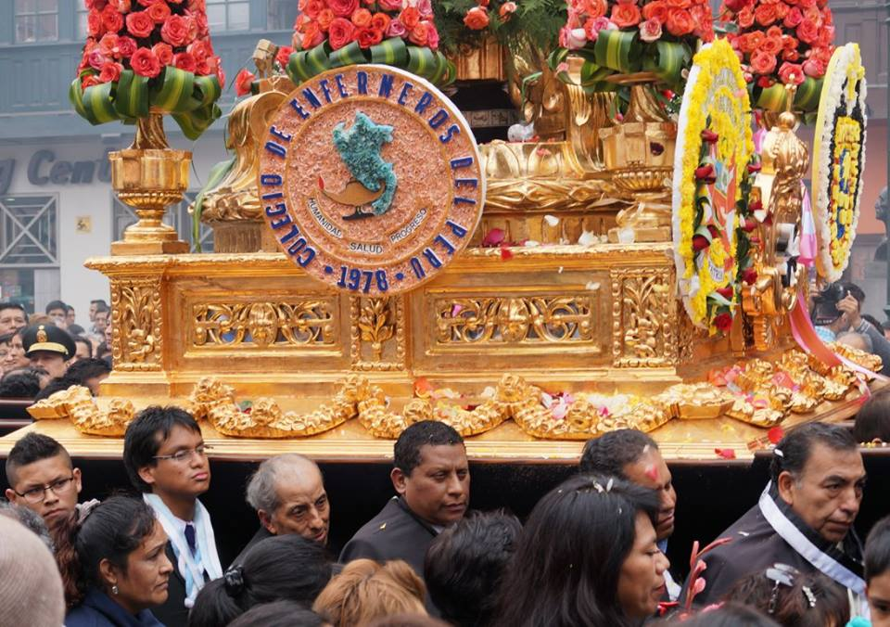

Slide 64
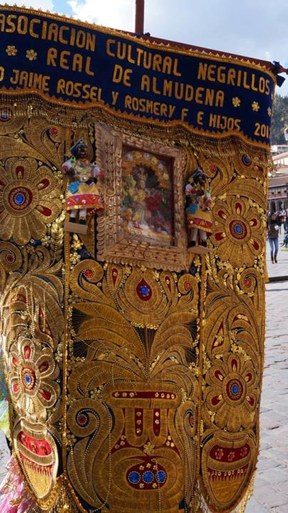

Slide 65
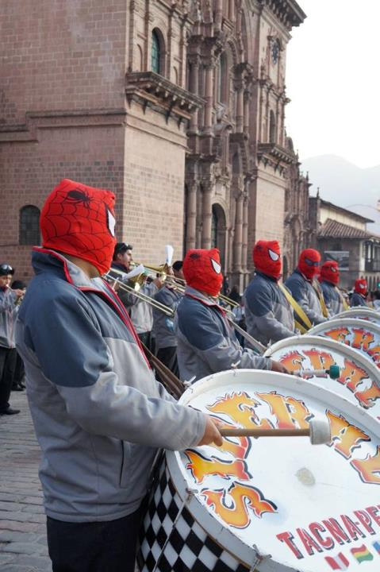

Slide 66
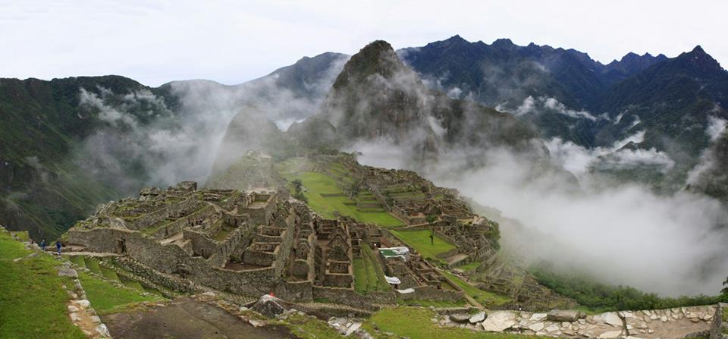

Slide 67
Mountain clouds haunt the skies A forgotten secret stretched out on a green haven Wooing those clad in nylon into its arms Llamas chew the cud for excited snappers filling their buckets Bodies in the foetal position listen to the whispers of the intrigued If you listen her majesty speaks as you carefully poke Designed and built by those high on the land's leaves Sun up til sun down the 'slaves' returned a favour for their beating heart Crevices reveal their secrets to those who dare to ask The celestial sky draws pictures to tease the ancient people Now void of the Inca's chanting that is until Spirits rise up when the last bus heads out

Slide 68
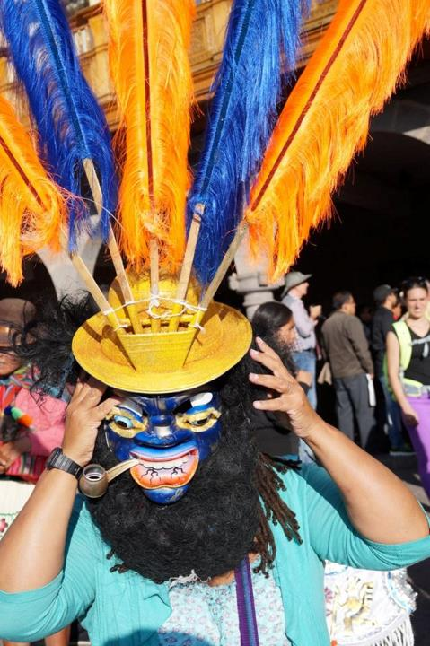

Slide 69
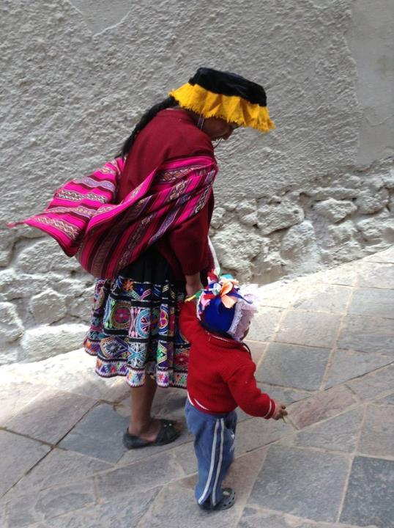

Slide 70
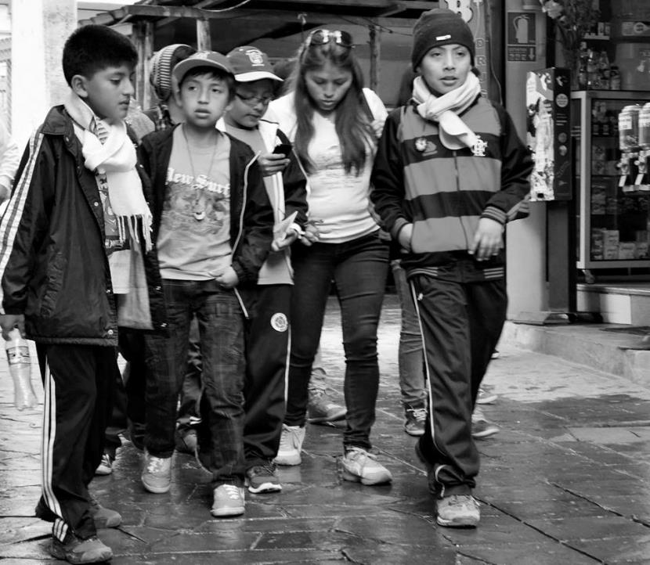

Slide 79
More Inca sites and a set of salt ponds, which again would leave you mystified as to talents of people and the wonders of our world. We remained enthusiastic and loved looking, being and taking photos to remind of us the thrill of walking in the steps of this sophisticated civilisation. Do I talk again about the terrifying bus journey or the affects of altitude on the steep climbs? - NO!

Slide 83
When we got back to the main square in Cusco about 3pm this day and there was a small gathering of local bands. I have to admit I was starving by this point, so after eating an empanada from the local street seller we ventured over to the music. What a sight! I had seen postcards of people dressed in costumes such as the ones I was seeing before my eyes now, but never did I think that we would actually see them prancing and dancing about in them before us. It was such a fantastic sight. About 20 groups consisting of bands and brightly and imaginatively dressed people. I stood mesmerised and smiling. A captive audience coupled with exuberantly dressed groups to praise God! Praise God! A colourful joyous and noisy affair performed before us and the accompanying bands competed simultaneously for my claps. They invited us to join in and posed frequently for photographs, it really felt like we were part of the affair. Little did we know that this 3 hour organised but at times chaotic jig was actually a practice for the next day's parade in the streets of Cusco to celebrate the Natividad de Virgen 2015. We felt so honoured.

Slide 95
Peru provided an attack on the senses. Firstly we encountered a several religious parades one in Lima and 2 in Cusco and they were without a doubt one of the highlights of the visit. A lively affair performed by people of all ages dressed up in all different costumes representing their community and faith – the festival was called Natividad de Virgen.

Slide 97
All of the cities we visited, except for San Jose, were colonial in style and no more than Cusco in Peru. Cusco was the heartland of the Inca’s empire and contained many Inca sites in and around the city. When the Spanish raided it in the 16th century it changed radically to what it looks like today. It was a beautiful old city 12000 ft above sea level and this altitude did cause us some problems, although Quito at 9000 ft above sea level had prepared us well and we were able to walk the well-known Inca site of Machu Picchu with relative ease.

Slide 98
We could not forget how the sights of Machu Picchu affected us. It is not possible to describe it well in my opinion, but I wrote a poem and there are photos which at least attempt to give the reader some insight into this majestic site. Ecuador had provided by far the best hot chocolate, like no other I had had before or since and I was determined to not leave ‘ this cocoa area’ without at least attempting to make and eat our homemade chocolate. It was a fun event which was shared with other tourists; we even bought some cocoa beans which we hoped we could turn into hot chocolate upon our return to the UK if we could get them through the many customs.
Peru had the most stunning vistas, just like Ecuador. Snow topped mountains and hills, some carved by hand by the Incas. The Peruvians are beautiful people and I could see the attraction of travel to this land. We would love to return.

Slide 99
ARGENTINA - SEPTEMBER – OCTOBER – SPRING 65-75 DEGREES
Argentina was the inspiration for the trip. Football, Gauchos, Artists, Tango and waterfalls. We love Argentina. I also met Dhanni, who is a friend’s son, from London who lives there now.

Slide 105
The Gauchos put their showmanship to great use as they herded the horses together with their sheep dogs and raced each other in competitive games. A great treat and one I really appreciated. The Gauchos are slightly forgotten people in Argentina. Their representation in art, music, food and horseman ship is not advertised as much as the sportsman, religious peeps and political figures of yore. Unsure why this is, as they are pretty unique group to Argentina and certainly provided much towards their current lifestyle loves - dancing, Parilla, polo, horse riding etc.

Slide 129
We were to visit 3 countries in quick succession and all blew our minds. Rio leaves you numb and tingling. A stunning city which dances all night long and it is full of lively favelas with lively and ambitious people, whereas Buenos Aires is cultured and fun loving and full of dancing people, political unrest, music and sport. With only one short visit to Uruguay it was difficult to get under its skin, but what we saw of it we loved. It felt very similar to Argentina, cultured, high spirited and ready to play its part favourably with the most highly regarded countries in the world.

Slide 130
BRAZIL –RIO DE JANEIRO – SUMMER - 80 DEGREES
Rio is the home of the 2016 Olympics. We saw 2 Wonders of the World in Rio. It is a very exciting city dancing, sitting on the beach and listening to music is something that people do every day!

Slide 137
A visit to South America would not have been complete without a tour of the majestic Iguazu, but this time on both sides of it - Argentina and Brazil. Each time we turned a corner whilst in the national parks we screamed Wow! It was a heavenly experience made all the better by seeing much wildlife.
During the crossing of the borders between Argentina and Brazil we would encounter some problems with immigration. They were easily sorted, but with no help from the police or immigration in Brazil and for our entire 5 day's stay we were illegal immigrants, but no-one seemed to care except us.

Slide 150
Whilst I see the Olympics in Rio will be a big success it will not be without its challenges and I would suggest that all who go plan the events and their visit well to avoid any pitfalls.
By the end of our South American tour we would have stayed in 25 hotels and visited 14 airports been on nearly every type of transport known to man including horses, motorbikes, cable cars and a dingy and had loads of adventure with water. Water featured a lot – the sink holes in Mexico where we went swimming in the freezing water and dove under to look at the caves, the rivers of Tortuguero where we thankfully only lost our cameras and not our lives, the river rapids in Banos near the Amazon, the waterfalls and the boat ride just above them in Iguazu, jumping and romancing with the waves on the beaches of Copacabana in Rio, Jaco in Costa Rica, Cancun in Mexico and Nerja in Spain and the numerous swimming pools including the highest one in Buenos Aires which had a 360 degree view of the city.

Slide 151
URUGUAY OCTOBER – SPRING - 75 DEGREES
Uruguay is very similar to Argentina. It is a very simple place with a beautiful coastline and wonderful people.

Slide 159
We played so many games in Argentina including tango lessons, riding horses, participating in events with gauchos, visiting an art gallery almost every day as well as pounding the streets while the activists or football fans pounded their drums on a daily basis through the streets and of course I must include drinking Malbec. It is such an inspirational city I defy anyone to go there and not love it.
We said goodbye to Central and South America and although we will never probably return we have lots of unforgettable stories that filled our hearts and minds.
Link to photos on Facebook from Caminito and Plaza be Mayohttps://www.facebook.com/media/set/?set=a.10208156652862177&type=1&l=ab9f54ab90

Slide 160
CAPE TOWN SOUTH AFRICA – SPRING 75-85 DEGREES
Marine 5 and The Big 5 were all ready and waiting for us. We loved South Africa and we learnt a lot about its history and its most influential leader Nelson Mandela

Slide 161
Link to photos on facebook
https://www.facebook.com/media/set/?set=a.10208284463937374&type=1&l=53d511e0e8
South Africa Was a truly inspiring and amazing experience. Initially it was difficult to watch my brothers and sisters suffer sometimes at the hands of their employers as I witnessed the lack of empathy, sympathy and respect. However this was observed in small doses and was not typical of the whole of Cape Town. South Africa is a complex country. One that ultimately is growing wealthier by the minute and is trying to share its wealth among its citizens fairly by spending it on health, housing, education for all and community projects, meanwhile it remains in the grip of the fall out from 50 years of apartheid and a corrupt government who still preferred to spend the money on themselves than the countrymen -Zuma, SA's president had just spent £13.2 million of government money on his private residence http://www.theguardian.com/world/2015/may/28/south-african-president-jacob-zuma-residence-upgrades.

Slide 174
I learnt a lot from the people I met. They humbled me. The person I am, because of the environment I live in and political and educational systems I have grown under, means I have a very different voice to many people of colour in South Africa, but I know hope and love when I see it. Most South Africans are beautiful people with a clear purpose in mind to live a fruitful and harmonious life. There is no doubt that their leader and mentor and for a short time their president Nelson Mandela inspired the blacks and whites to pursue this lifestyle. He is an inspiration to the people to this day and that undoubtedly will be his legacy. I could feel his spirit among the people. There is much love there, but the spirit for community and harmonious living is palpable. After leaving the suburbs I felt and saw a very different South Africa - hope is in the air.

Slide 178
We stayed mainly in Cape Town taking in tours across the western cape including, Cape Point, safari in Oudsthoorn, a wildlife park, an ostrich farm, Hout Bay, shark cage diving, whale watching where we also saw penguins, Dolphins and seals, Hermanus Bay, seal watching off an island, Boulders Beach to watch the Penguins, District 6 museum, Company's Garden, South Africa's national museum and art gallery, Parliament House, Table Mountain, Signal Hill to watch the sunset, Gold Restaurant an evening of traditional African fun and entertainment, Clifton Beach, a harbour tour, swim in the 50m sea water pool, wine tasting, Kirstenbosch Gardens and annual art exhibition, elephant riding, World of Birds, walking with lions, Robben Island and township tours. Such fun was found in and immediately around Cape Town.

Slide 184
The history of apartheid was standing loud and proud and much attention was given. What it lacked was any attention to the indigenous people of South Africa, which to me was the elephant in the room and something to really celebrate. It is difficult to celebrate apartheid even if it is now in the past.
Southern Africa's indigenous peoples.
San people, who are indigenous to Southern Africa. Southern Africa generally includes lands from the Cape of Good Hope northwards to the borders of Democratic Republic of the Congo and Tanzania, and islands such as Madagascar. * San: Kalahari Desert, Botswana/Namibia * Khoikhoi: South Africa * Namaqua: South Africa

Slide 188
I spoke to many South Africans, mostly black, about living and working in South Africa and it was obvious that it was a game of 2 halves. People are happy to work and to serve but some still lived in absolute poverty with little positive hope for the future whilst others managed to get by on their wage and help build a positive future for themselves and the next generation. There was a minimum wage, although not all employers observed this, and this was helping many to build the future.
Most blacks saw the changes over the last 21 years as a positive thing although at times there were comments that concerned me like the references about other African nationals who had migrated to also benefit from this rapidly booming country. I needed to buy some much needed underwear from a department store. There are many people who are employed that are surplus to requirement and this store was no different. A black meeter and greeter was on the door who was talking to a customer about returning some goods. She directed her downstairs and told her who to see. I followed, bought my goods and came back upstairs. The girl who served me had not taken the security tag off and so the alarms went off. The meeter and greeter searched our bags, found the items and removed the tags. Meanwhile the customer returned to her to say that no one would help her and so was upset. 'Who said no one could help you?' She barked. 'Was it that African woman? Oh she's useless and has no right to say that. Take it back down and see....' She continued. Other derogatory references were heard too about immigrants about taking jobs, homes, using healthcare etc. Sound familiar?!

Slide 193
Housing was an interesting one.https://en.wikipedia.org/wiki/Township_(South_Africa) Townships were on the edge of the city and millions of people lived in these. When the group act was declared in SA areas were designated for certain colours only ie whites, blacks, coloured and Malays. So in the 1960s people were displaced in their hundreds of thousands and moved into townships that are still there today. District 6 was a poignant place which essentially housed many people of all colours including whites but was razed to the ground, people were displaced and to this date the ground lays ghostly and void of housing and a community.

Slide 194
Men and their families were separated as coloureds and blacks were not allowed to live together and so these men were put into hostels built for 2 but had 6 or more in them. Some of the homes were small bricked bungalows with bathrooms and some are made of shanty town corrugated steel with communal toilets around the edge of the towns. The government did raze some of the shanty towns to the ground and build some homes during the preparations for the World Cup but these were just a handful of what was needed to house generations of people. We took two tours of the townships and were humbled both times. He people were loving and welcoming and on the streets a community who was mother to all could be found. Children were looked after by the community, whether this was shown in a cuddle or in a reprimand or in a walk to school they were cared for by everyone. Children helped at home by selling goods on the streets, washing hair keeping the home tidy but also played together happily on the streets. Hairdressers and barbers were springing up in the containers that had been hawked from the harbours or bought legally to inspire enterprise.

Slide 195
The Cape Town city sightseeing bus was a revelation, the best tour bus we had encountered which allowed you to get the best out of your trip. It had a wine tour stopping st 3 different wine estates, a peninsula tour which took in the beaches, the townships and the botanical and bird gardens, a harbour tour which was a narrow boat ride around the harbour, a city tour which took in Table Mountain and other key landmarks, the museum tour or yellow bus which took you to the castle, District 6 the Jewish Museums and the sunset tour which allowed you to experience the most amazing sunset over the bay from the rump of Lion's Head which also overlooked Table Mountain. It was a fantastic tour, well organised and available every 20 minutes from 9-6 everyday. Staff were humble, always smiling and very helpful; an effective and highly professional team which ensured your visit to Cape Town was the best it could be. By far the best value for money tourist attraction in the Western Cape. Sorry lions!

Slide 198
Many black people over 25 have not had formal education and so find it difficult to get employment, housed etc. And so some of these have been given a house. This, some believe, is breeding contempt and there was a feeling among some Capetonians that it was make a generation of people lazy and ungrateful. One guy said 'They were given a house for being lazy and they wanted to make money out of it so they moved back to their shanty home. They're disgusting if they want to live like that. There is no need for it. I wasn't given a home, I like everyone else had to work for it.' Again, is this a familiar rhetoric?!
The understanding of blacks and coloureds was complex too as we met one man aged about 45 who said that his parents were both Malay but one was light skinned and one was dark, so his mother and father were not allowed to live together. His father was allowed to visit him once a month and had to get a permit to do this, again a lengthy and unnecessary process. If the father saw them without following the rules he would be thrown immediately into prison for 6 months. There were so many sad stories about apartheid and the fall out, but Capetonians are trying to rise, like a Phoenix, from the ashes and that is something to celebrate.

Slide 199
Cape Town and the Western Cape has the most beautiful landscape and vistas anyone could wish for from the mountain to the seas from the oceans to the islands the vistas are breath-taking and clear. Often the sea mist comes over the bay and you bask in this. Table Mountain often closes when it is cloudy to ensure people are safe, so they don't walk over the edge. The safety of others is paramount all over CT. no mobile phones whilst driving, seat belts are mandatory as are life vests when on shark or whale watching boats. Speed limits are observed and there is a general feeling that rules are obeyed, after all this is the land of law enforcement.
Education will make the difference between the haves and have nots and in SA that means between the blacks and whites. Not just education in schools, but at all levels for all ages through advertising campaigns, museums, magazines and libraries etc. for police, for the government, for the leaders, for the hoteliers, restaurateurs etc. who like the 'old ways'.
If I have ever seen a nation that I have every confidence in that it will achieve its vision it is this one. I have less faith in Brazil who doesn't seem so sure of its recipe for success yet. I wish them all the best and thank them for opening their doors to and welcoming us so warmly.

Slide 203
https://www.facebook.com/media/set/?set=a.10208283594955650.1073741928.1476834756&type=1&l=6b76fc49a9
Shark Cage Diving
Shark cage diving. Really? Me? Never? I looked up incidents involving shark cave diving and was horrified to see that a shark had managed to enter the cage, but left the people unharmed. Again I considered if my safety was going to be compromised. I had come this far and knew there would be some challenges but death or a chewed ear by a shark wasn't one I was prepared for!
When I read the blurb about the trip by Marine Dynamics I was tempted, the fact that you could watch the Sharks from above the sea enticed me in and that their practices were green, conservative and harmless to the Sharks made me comfortable. It was keŷ that we were to pay attention to the top 5 dos for avoiding sea sickness if we were to enjoy the experience. Having heard that sharks preferred warmer water which in SA is often choppier than the seas around Hermanus we would be prepared for a bumpy ride. John on the other hand had no intention of following those rules and so stocked up on latte, eggs, tomato, ham and was determined to look at the Sharks rather than the horizon. So it was no surprise that within an hour the stock up was chucked out.

Slide 204
This time we didn't have to wait very long for the Sharks, who were drawn in by the bait and chump, to join us. I changed into my wetsuit and was keen to get in the cage as long as I wasn't in the first cohort. It wasn't long before I was called and I hotfooted it down the ladder and was first into the cage. Being short I couldn't reach the floor so I used the bars to pull myself to the end. See photo of being at the end. It was clear that being at the end had its advantages. You would not only get a frontal view but also a sideways one too. The water was warmer than I had anticipated at 17 degrees; Bath University's 50m pool is 18 degrees and most sports centres are 26. We were given instructions on what to do and I practised before the Sharks visited us. The skippers or 'shark lookers' would shout 'down, down, down left or right or forwards', to let you know to go under the water to view the Sharks swimming past you or, on some occasions, terrifyingly towards you. OMG! Towards me. It was a thrill a minute. I went under the water on the second call and came face to face with a shark. Stunned I came up for air immediately, disbelieving that I had come face to face with one of the seas most incredible creatures and only a thin bit of wire separated us. Like with most new things, once I relaxed and practised going underwater I grew in confidence and loved watching these huge, majestic and finely engineered creatures zipping or gliding towards me in their natural habitat.

Slide 205
You always knew there was a shark close by as the shoal of 100+ fish scattered in less than a second. It was magical to see this. There were several things I hadn't been prepared for while in the cage and one was the push and pull of the current. Once under I had to hold on tight to the internal bars making sure that my fingers stayed inside the cage as the current pushed and pulled me. I would nearly land on top of my fellow passengers, not the best thing to do in close proximity but it was so difficult to stay still. It really was a fantastic experience that again I loved.
We saw 11 sharks in all, one giant stingray and again several whales; a spectacular sight. I saw a breaching whale and a shark which dove fully out of the water. I didn't take any photos other than with my waterproof camera, but shared the ones from my fellow passengers.

